Slide 1


Book Summary
8/4/2016 Ver. 1.4.2

Slide 2

PUBLISHER, EDITORS & CREDITS
Published By:
Advantage Books
www.advbookstore.com
Editors:
Brian Gibson (M.D., Physician)
Eric Hanson (Masters of Divinity)
Dawn Burke (Masters in English)
Copyright © 2014 by Jeff Woodward, all rights reserved.
No part of this publication may be reproduced or transmitted in any way by any means – electronic, mechanical, photocopy, recording, or otherwise – without the prior permission of the copyright holder, except as provided by USA copyright law.
Cover (modified center): Artist’s impression of black hole accreting a cloud of dust and gas. Credit: NASA.
All Bible references are from the King James Bible from Zondervan Corporation L.L.C. unless stated otherwise. Scripture quotations marked (NIV) are taken from Holy Bible, New International Version®, NIV®. Copyright © 1973, 1978, 1984, 2011, by Biblica, Inc. ™ Used by permission of Zondervan. All rights reserved worldwide. www.zondervan.com ”NIV” and “New International Version” are trademarks registered in US Patent and Trademark Office by Biblica, Inc. ™

Slide 3


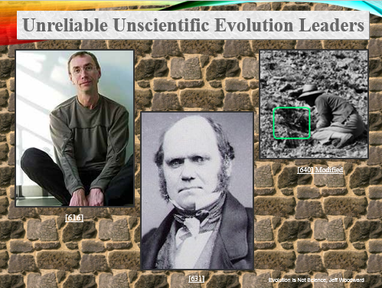
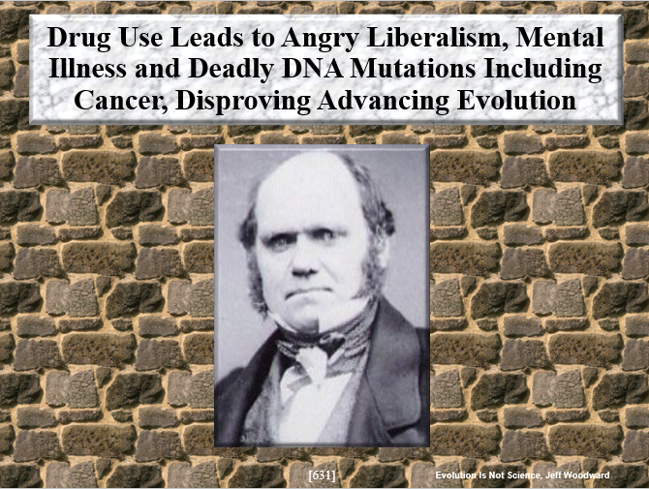
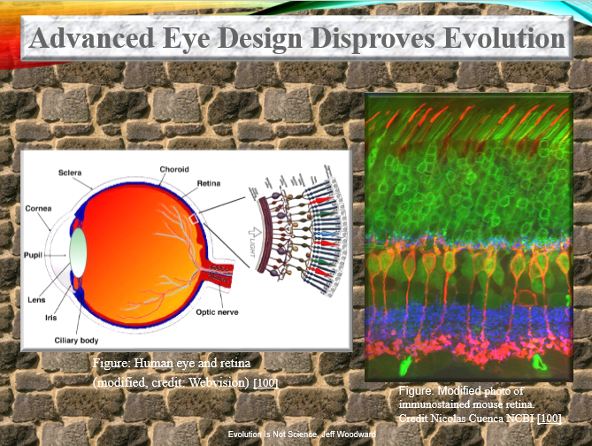
TABLE OF CONTENTS
INTRODUCTION
Unreliable Unscientific Evolution Leaders
Drug Use Leads to Angry Liberalism, Mental Illness and Deadly DNA Mutations Including Cancer, Disproving Advancing Evolution
Advanced Eye Design Disproves Evolution

Slide 4
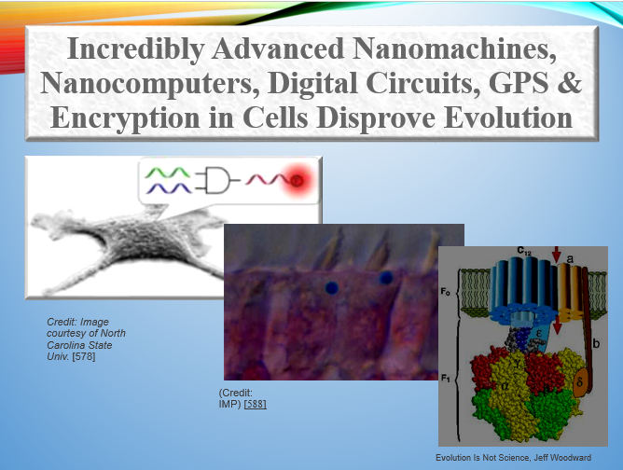

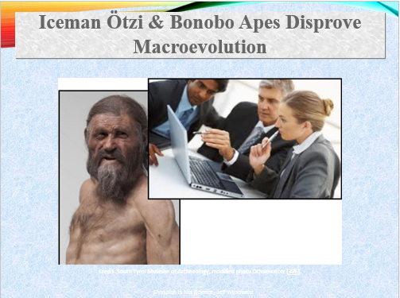
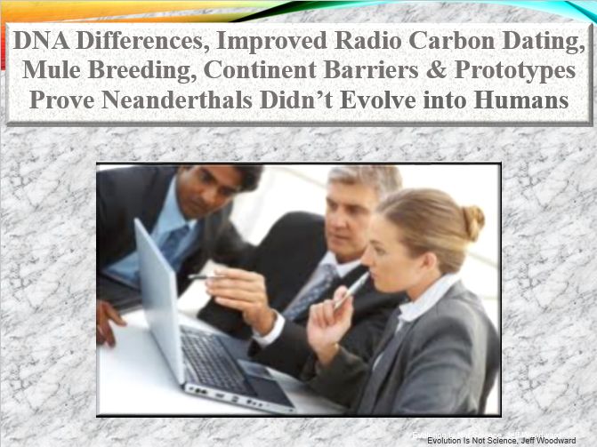
TABLE OF CONTENTS
Incredibly Advanced Nanomachines, Nanocomputers, Digital Logic, GPS & 3D Encryption in Cells Disprove Evolution
Chemotherapy, Stable Metamorphosis, DNA Breakpoints and Extreme Natural Environments Disprove Macroevolution
Iceman Ötzi and Bonobo Apes Disprove Macroevolution
DNA Differences, Improved Radio Carbon Dating, Mule Breeding, Continent Barriers & Prototypes Prove Neanderthals Didn’t Evolve into Humans

Slide 5
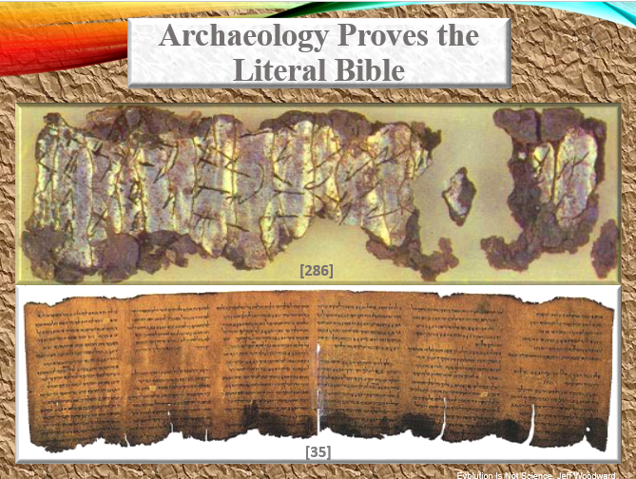
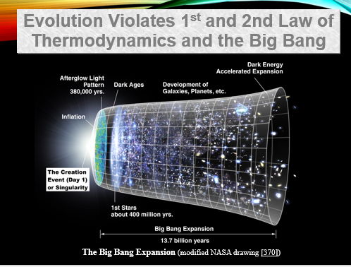
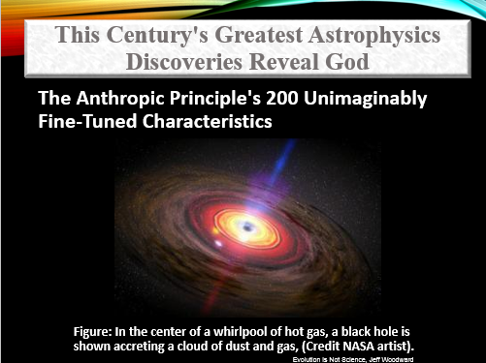
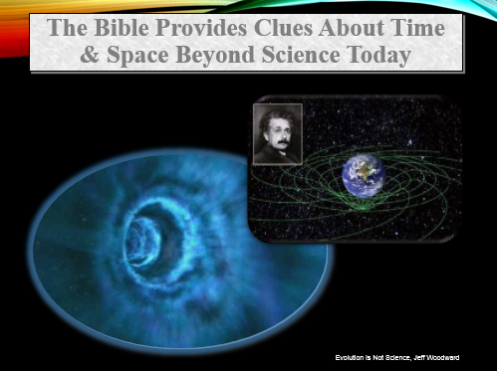
TABLE OF CONTENTS
Archaeology Proves the Literal Bible
Evolution Violates the 1st and 2nd Laws of Thermodynamics and the Big Bang
This Century's Greatest Astrophysics Discoveries Reveal God
The Bible Provides Clues About Time & Space Beyond Science Today

Slide 6
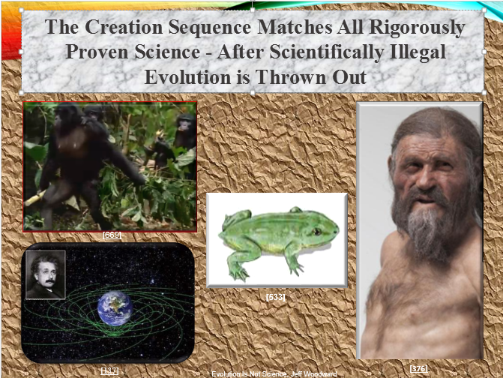

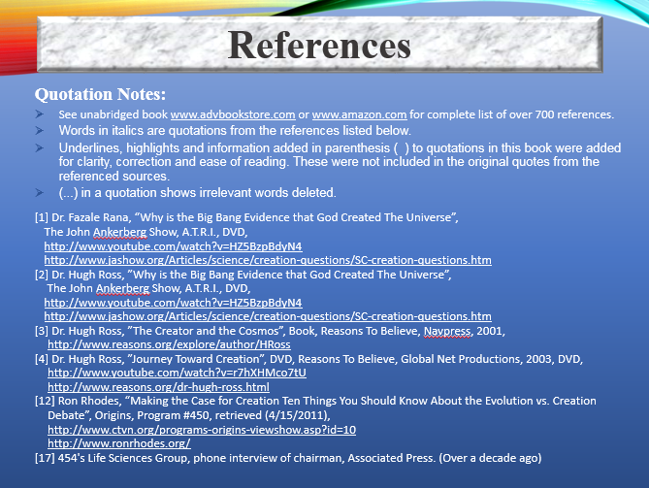
TABLE OF CONTENTS
The Biblical Creation Sequence Matches All Rigorously Proven Science - After Scientifically Illegal Evolution is Thrown Out
Miracles Analyzed Using the Rigorous Scientific Method Disprove Evolution
References

Slide 7
INTRODUCTION
Dismantles the Dead Tree of Evolution and Painful Deceitful Interconnected Junk Sciences that Support It
Radical Angry Liberalism
Forced Homosexuality
Murderous Abortion
Erroneous Revised History
Radical Angry Feminism
Violent Mind Altering Drugs
Addictive Pornography
The Global Warming Fraud
Murderous Junk Religion of Islam

Slide 8
INTRODUCTION
4th Edition Book Contains:
750 Pages, Over 700 References
220 Rigorous Scientific Proofs
Over 100 Video Links for Visual Learners
Available in:
eBook, Hardback and Paperback Format
Book Summary Lecture Series (this presentation)
This book provides scientific answers about God, science and the origins of life, including archeology, space-time, angels, miracles and fulfilled Bible prophesy that confirm the literal Bible.
www.advbookstore.com

Slide 9

INTRODUCTION
This book meets rigorous scientific standards and uses repeatable testing and multiple independent reinforcing test methods per the scientific method.
Discoveries from every field of science now fall into place like pieces of a giant puzzle. The resulting big picture is in agreement with all literal words of the Bible that were far more advanced than imagined.
This revolutionary book unites Young Earth and Old Earth Creationists for the first time, using Transcendent Creation literally described in many overlooked Bible verses, in shocking agreement with the most advanced space-time science today, that shows that time is an illusion.

Slide 10
INTRODUCTION
This book boldly crashes through the walls of evolutionary ignorance and deceit to present the scientific truth, wherever it leads, without artificial man-made boundaries on what science can study.
Evolution doesn’t follow the required scientific method. Evolution is a phony science that calls itself science, while violating several bedrock laws of science.
This book disproves illogical accidental Godless macroevolution and nonbiblical theistic evolution.
I embrace small variation “after their kind” within the borders of the original first kinds, as described in the Bible for fish, whales and humans.

Slide 11
INTRODUCTION
This 4th edition book and summary version took 6 years to write and includes the results of extensive peer review and research for over 30 years with over 300 debates with leaders from every field of science and religion.
No one could rigorously scientifically refute the information presented in this book.
90% of the Christian leaders I debated with later agreed with the information presented in this book, sometimes after months or years of research.
40% of the evolutionists, atheists, agnostics and homosexuals I debated with later became Christians. They were freed from their painful traps and lies.

Slide 12
QUALIFICATIONS
Senior Electrical and Test Engineer,
Project Team Lead, 20 Years Experience
Electrical engineer for intentionally designed systems that resemble far more advanced designs found in life, that build, test and repair themselves.
Honeywell*, Orbital Sciences*, Kaman Aerospace*, Alanco*
Avionic flight control and navigation systems for the most advanced jets and rockets in the world today.
High performance adaptive optic camera systems & sensors
Cell phones, RF communication systems, GPS systems
Multicore computer systems, wearable electronic systems
Fiber optic systems, robotic systems, software programming

Slide 13
QUALIFICATIONS
Private Research Scientist & Book Author
6 Years
30 Years of Scientific Research in the Following Fields:
300 science books and 5,000 research articles
Taught Digital Electronics at DeVry University*
Researched nearly every evolution research article
The causes, effects and pain of radical liberalism, homosexuality, abortion, illegal drugs, date rape, mental illness, pornography, feminism, revised history and global warming
Most world religions and world cultures
Biblical archeology, miracles and prophesy

Slide 14
QUALIFICATIONS
Education
B.S. Electrical Engineering, Arizona State University 1992
Completed all coursework towards a second Engineering B.A. at Slippery Rock University, 1988
The final result of all this lifelong research and education is that science greatly confirmed my belief in the Bible.
* Not affiliated with this book

Slide 15

Guiding Principles of the Bible

Slide 16

Guiding Principles of the Bible
Paul wrote that not even an angel could change the scriptures:
“But though we, or an angel from heaven, preach any other gospel unto you than that which we have preached unto you, let him be accursed” (Gal. 1:8).
God said we could not change one word of Bible:
“... thou shalt not go aside from any of the words which I command thee this day, to the right hand or to the left...” (Deut. 28:14)
We can't add or delete one word of the Bible:
“For I testify until every man that heareth the words of the prophesy of this book, If any man shall add unto these things, God shall add unto him the plagues that are written in this book. And if any man shall take away from the words of this prophesy, God shall take away his part out of the book of life... (Rev. 22:18-19)

Slide 17

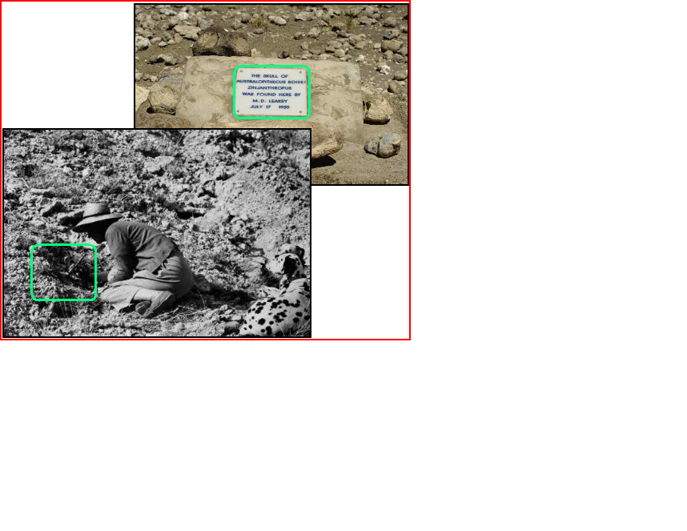
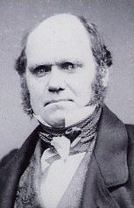
Unreliable Unscientific Evolution Leaders
[640] Modified
[616]
[631]

Slide 18
Unreliable Unscientific Evolution Leaders
Charles Darwin
Scientifically illiterate
Failed Bible theologian
Disproven theories
Deadly drug user
Clinically mentally ill [630][631][632][633]
[640] Modified
Louis, Mary & Richard Leakey
Scientifically illiterate
Disproven, corrupt research
Louis started widespread corruption of university science programs by awarding large numbers of fraudulent Ph.D. and honorary degrees to illicit sex partners as kickbacks. [526][538][541][543][640][716]
[616]
Svante Pääbo
Radical California liberal from Berkeley University
Blundering bisexual
Studied Egyptology, not DNA, discredited research
Fraudulent DNA Ph.D. degree and fraudulent professor job [614][615][616]
[631]

Slide 19
Unreliable Unscientific Evolution Leaders
Evolution leaders were the least qualified, most corrupt, scientifically illiterate, with virtually no science schooling.
University degrees of most evolution leaders were worthless honorary degrees or fraudulent unearned Ph.D. degrees.
This explains why evolution doesn't follow the required scientific method and violates several laws of science.
To understand God's designs in nature, you need an engineer who understands engineering design methodology.
Evolutionists are not qualified to understand design, because they have never designed anything complex.

Slide 20
Unreliable Unscientific Evolution Leaders
Louis Leakey was scientifically ignorant and erred greatly, yet he obtained a phony honorary Ph.D. degree from Oxford. [502]
Leakey's 2nd wife Mary received 4 phony honorary Ph.D. degrees, after never finishing high school or any college. [543]
12 phony honorary Ph.D. degrees, a professor job and university chair position were all awarded to their son Richard Leakey, who never attended a single university science class. [526][538]
Louis Leakey arranged for his mistresses (including Jane Goodall, who never completed any science class), to obtain a fraudulent Ph.D. degree, plus 7 phony honorary Ph.D. degrees. [538][541]
Leakey’s friends started the Leakey Foundation, claimed to be the #1 funding source for evolution research in the USA today. [504][507]

Slide 21
Unreliable Unscientific Evolution Leaders
Pääbo Follows the Liberal Evolutionist Pattern
Swedish Svante Pääbo grew up in a broken home without his father.
He studied Egyptology (not genetics) at radical liberal Berkeley University in California. [614][615]
Pääbo became a liberal atheist bisexual, then moved to Germany, where he claims only a few religious Americans pester him about creation. [617][618]
[616]
Pääbo: “I've had both boyfriends and girlfriends in my life —but at some point I had a girlfriend who was from Munich... I became a full professor there... without being an assistant professor... (there was a) constellation of people there who were not risk-averse (his illogical sloppy science was accepted without proof)." [614][615]

Slide 22
Unreliable Unscientific Evolution Leaders
Pääbo's blundering bizarre history:
Admitted that he greatly blundered on his Ph.D. thesis (finding nuclear DNA in Egyptian mummies, that no one can reproduce).
Professor at Max Planck University without proper credentials.
Previous “Neanderthals are related to humans” conclusion admitted by Pääbo to be due to lab contamination.
Contradicted his own prior mtDNA research conclusions. He now states that humans ARE almost exactly the same as Neanderthals.
Pääbo's starting assumptions are disproved and illogical. His final conclusions do not match the rigorous archeological evidence.
Pääbo states “... I must admit that if I’m confronted with existential questions or life-and-death things, I tend to become irrational and also think in magical ways.” [617]

Slide 23
Unreliable Unscientific Evolution Leaders
Scientists put Darwin on a scientific pedestal. But he had no science degree and virtually no science education.
Darwin was ignorant about the fundamental laws of science that his illogical theory of evolution violated.
Darwin was a drunken college dropout, animal stuffing taxidermist, amateur bug collector and failed Bible theologian. [24][583][633]
[631]

Slide 24
Unreliable Unscientific Evolution Leaders
Darwin plagiarized small variation “after their kind” from the Bible that described this for animals and humans.
Darwin originally correctly believed that God created all original kinds of species, and then God let them vary slightly.
God said Esau would form new nations and be born different, a strong hunter. Esau was born red and hairy all over and formed new nations. Today Russians are very hairy and Irish have red hair.
And the LORD said unto her (Rebecca), Two nations are in thy womb, and two manner of people... one people shall be stronger. And the first came out red, all over like an hairy garment... Esau was a cunning hunter, a man of the field; and Jacob was a plain man… (Gen. 25: 23-27)

Slide 25
Unreliable Unscientific Evolution Leaders
Day 5
... So God created the great creatures of the sea and every living thing with which the water teems... according to their kinds, and every winged bird according to its kind... (Gen. 1:20-23 NIV)
God created great whales, and every living creature that moveth... after their kind, and every winged fowl after his kind...” (Gen. 1:21)
Day 6
God said, “Let the land produce living creatures according to their kinds: the livestock, the creatures that move along the ground, and the wild animals, each according to its kind...” (Gen. 1:24 NIV)

Slide 26
Drug Use Leads to Angry Liberalism, Mental Illness and Deadly DNA Mutations Including Cancer, Disproving Advancing Evolution
[631]

Slide 27
Drug Use Leads to Angry Liberalism, Mental Illness and Deadly DNA Mutations Including Cancer, Disproving Advancing Evolution
"Darwin focused on his studies and was delighted by the language and logic of William Paley's Evidences of Christianity”. [24]
"He liked the thought of becoming a country clergyman, and before studying at the University of Cambridge, 'as I did not then in the least doubt the strict and literal truth of every word in the Bible, I soon persuaded myself that our Creed must be fully accepted.‘” [632]
Darwin told us the lack of transitional species was a problem for evolution. We still have found none.
Millions of transitional fossils are the most basic requirement for evolution, we must find exponentially more “transitional” fossils than fully formed fossils.

Slide 28
Drug Use Leads to Angry Liberalism, Mental Illness and Deadly DNA Mutations Including Cancer, Disproving Advancing Evolution
“At both universities, he (Darwin) saw how evolution was associated with radicals and democrats seeking to overthrow society..." [632]
After heavy college alcohol and later narcotic drug abuse, Darwin slowly changed from Christian conservative Creationist, to agnostic mentally ill evolutionist. [632] [24]
After alcohol and drugs killed much of his logical brain cells, Darwin changed his theories and removed God. [24][632]
Shortly after his rejection of God, Darwin's health deteriorated rapidly. [24][632]

Slide 29
Drug Use Leads to Angry Liberalism, Mental Illness and Deadly DNA Mutations Including Cancer, Disproving Advancing Evolution
Darwin's heavy drinking plus addictive opiate codeine medication plus arsenic and strychnine, (poisons that kill humans), led to a diagnosed severe mental illness with hysterical crying and panic attacks most of his life.
[24][187][517][583][630][632][749]
Darwin fell away from his Christian faith during the Beagle boat voyage. Darwin stated this occurred because archeologists couldn’t find ancient Bible manuscripts in the volcano destroyed city of Pompeii. [633]
But many ancient Bible manuscripts are available today, including the 2,200 year old Dead Sea Scrolls.

Slide 30
Drug Use Leads to Angry Liberalism, Mental Illness and Deadly DNA Mutations Including Cancer, Disproving Advancing Evolution
Darwin's Life Disproves Evolutionary Natural Selection Survival of the Fittest
Darwin was exceedingly weak and sickly with severe mental illness. [630][632]
Yet, Darwin had several children from a loving Christian wife.
Darwin was terrified to leave his own home and had at least one complete mental breakdown. [630][632]

Slide 31
Drug Use Leads to Angry Liberalism, Mental Illness and Deadly DNA Mutations Including Cancer, Disproving Advancing Evolution
For 30 years, I researched similar drastic personality changes that occurred in close friends, family and colleagues.
Multiple interconnected causes typically included: narcotic drug use, extreme fear, painful broken families, homosexual date rape and molestation, pornography, erroneous revised history, radical feminism and radical liberalism.
This led them away from God into mental illness, raging anger, violence, mind altering drug addictions, homosexuality, evolution, murderous abortion and great depression.

Slide 32
Drug Use Leads to Angry Liberalism, Mental Illness and Deadly DNA Mutations Including Cancer, Disproving Advancing Evolution
"These findings are of great clinical relevance given recent evidence suggesting that exposure to marijuana during adolescence can increase the likelihood of developing schizophrenia later in life, …“ [187]
"We know there are abnormalities in both the amygdala and prefrontal cortex in patients who have schizophrenia, and we now know these same brain areas are critical to the effects of marijuana and other cannabinoid drugs on emotional processing." [187]
“The Centers for Disease Control and Prevention in 2013 stated that... 'published studies report that about 25% of all U.S. adults have a mental illness and that nearly 50% of U.S. adults will develop at least one mental illness during their lifetime'." [517]

Slide 33
Drug Use Leads to Angry Liberalism, Mental Illness and Deadly DNA Mutations Including Cancer, Disproving Advancing Evolution
  Using sophisticated technologies and rigorous research, scientists are today confirming that exposure to smoking marijuana can lead to deadly DNA mutations including cancers in adults, that can be passed on to their children, including birth defects. [748]
Additional subtle, significant later deficits in some children exposed to cocaine include:
  Behavior problems and difficulties with self-regulation. [749]
  Deficits in cognitive performance, information processing, language, memory and sustained attention to tasks. [749]
  Some deficits persist into later years. [748][749]

Slide 34
Drug Use Leads to Angry Liberalism, Mental Illness and Deadly DNA Mutations Including Cancer, Disproving Advancing Evolution
Brain scans in teens suggests that some brain regions including areas involved in attention, planning, and language—may differ from that of non-exposed peers.” [749]
Corrupt liberal researchers tried to use junk science to refute these rigorous scientific findings to justify:
  The use and legalization of narcotic drugs nationwide.
  The legalization of billions of dollars of illicit revenue.
  Ignoring the painful traps of tens of millions of people caught in drug addictions, violent crimes, sexual perversions and mental illnesses, from narcotic drug use.

Slide 35
Creation Survey
Evolutionists impose unscientific man made limitations on what science can study.
True science demands that we follow the evidence to whatever conclusion it leads. Pure science, without error, leads to God.
A 2012 Gallup survey reported that 46 percent of Americans believe the creationist view that God created humans in the present form, at one time, within the last 10,000 years. [534][682]
Only “15% say humans evolved, but God had no part in the process.” [534][682]
I personally observed, and published polls verified, that 35% of engineers and scientists in the USA believe in Creation, not evolution.

Slide 36
Christians Were the Best Engineers & Scientists
Newton (considered the greatest scientist who ever lived) [257][259]
Galileo (discovered the telescope, confirmed planet orbits), "infinite thanks to God for being so kind as to make me... first observer..." [387]
Louis Pasteur (disproved evolutionary Spontaneous Generation, developed vaccines and pasteurization; his tomb states “...virtues of the gospel”) [253][254][257]
Johannes Kepler (Kepler's laws of planetary motion) [257]
James Maxwell (formulated electromagnetic theory [257][260]
Michael Faraday (electromagnetic field concepts) [257][258]
Francis Collins (led Human Genome Project, 1st to map human DNA)
Raymond V. Damadian (inventor of the MRI) [72][255]
Wernher Von Braun (father of the American space program) [72][73]
Jim Irwin (8th Moon astronaut, geologist, discovered Genesis Rock)

Slide 37
Christians Were Best Engineers & Scientists
Newton's study of the Bible was one of his greatest passions.
He wrote “Observations upon the Prophecies of Daniel”. [257] "Newton saw God as the master creator whose existence could not be denied...“ [259]
Christians throughout history were the greatest scientists and engineers. It is great Christian scientists and engineers who are needed once again to correct the great errors in science today.
Scientists have learned that when they disagree with the Bible, eventually they are proven wrong.
After his non-expanding steady state universe blunders were disproved by Hubble, Einstein later in his life came to believe in Intelligent Design and a God that created the universe, with a beginning that is expanding, exactly as the Bible stated. [3][256]

Slide 38
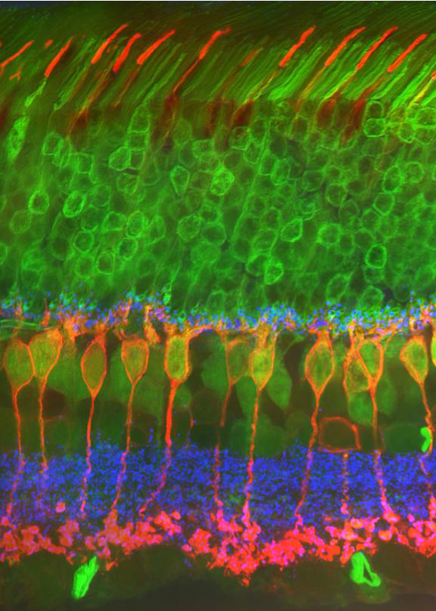
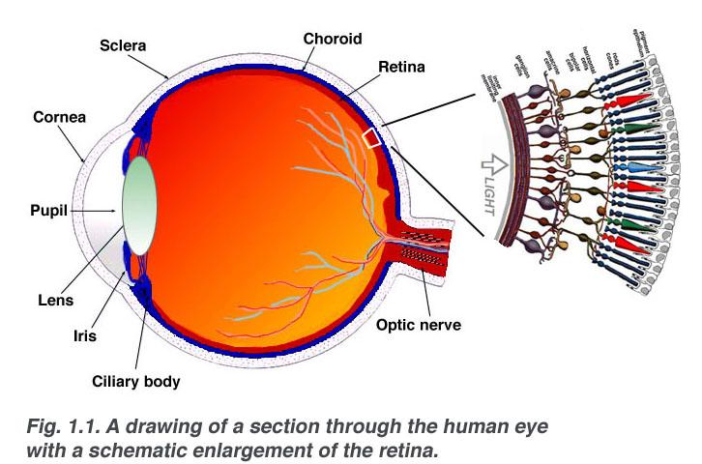
Advanced Eye Design Disproves Evolution
Figure: Human eye and retina (modified, credit: Webvision) [100]
Figure: Modified photo of immunostained mouse retina. Credit Nicolas Cuenca NCBI [100]

Slide 39
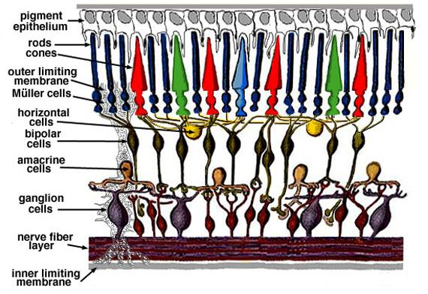
Advanced Eye Design Disproves Evolution
Video - Vision, Light & Neuron Activity
www.youtube.com/watch?v=AuLR0kzfwBU&feature=related
[538]
[616]
Figure: Human eye and retina (modified, credit: Webvision) [100]

Slide 40
Advanced Eye Design Disproves Evolution
Retina: Bipolar Cells and Rods of a Mouse
Top layer: red cones (for color vision), green rods (for black and white vision).
Bipolar cells (middle orange) send dendrites (thin faint green lines middle top) above to (color vision) cones in outer plexiform layer (top green). These thin green dendrites end at bipolar cell synaptic ribbons (thin middle blue layer). [100]
Bipolar cells (orange middle) end at inner plexiform (bottom green) layer where they terminate close to ganglion cells. [100]
Figure: Modified photo of immunostained mouse retina. Credit Nicolas Cuenca NCBI [100]

Slide 41
Advanced Eye Design Disproves Evolution
Project manager for the design of an advanced aerospace camera computer systems with:
Advanced adaptive optics
Dual frame grabbers (2 circuit boards)
1/2 frame mapping and auto-focusing
JPEG, MPEG video signal compression to reduce data loading.
Group delay matching, clock gated pixel signals in parallel wires.
Parallel image processors for frame image reconstruction.
Signal feedback for auto image, color and contrast.
Ruggedized liquid cooled protective metal housing with shock absorbing pads to survive impacts, vibration and temperature extremes.

Slide 42
Advanced Eye Design Disproves Evolution
Human eyes are better than an ultra HD camera at contrast and faint detail
“Like pixels in a (200 megapixel) digital camera, each photoreceptor generates an electrical response proportional to the intensity of the light falling on it...” [120][ 195] .
Human eyes use retinal image compression
“… Retina spatially encodes (compresses) the image to fit the limited capacity of the optic nerve.” [195].
Human eyes have 3D vision with relative velocity object image mapping
The brain has neurons that specifically measure our motion, perspective, and how objects pass in front of or behind each other to recreate the 3D world in our minds [118] .

Slide 43
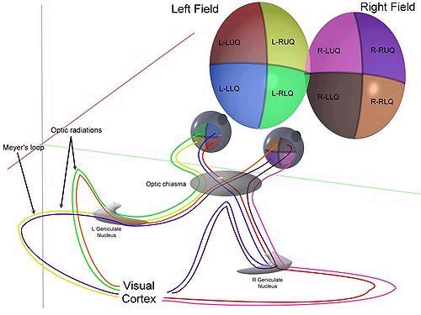
Advanced Eye Design Disproves Evolution
Retina and Brain Vision System with 1/8 Frame Mapping & Image Reconstruction
Video signals from each quadrant of the human eye are mapped to the brain, where 8 separate video images are seamlessly reassembled into one image. [195]
This is remarkably similar to 1/2 frame mapping and pixels image reconstruction used in high performance camera systems.

Slide 44
Advanced Eye Design Disproves Evolution
I was Humbled by the Far More Advanced Adaptive Optics Human Vision System that Includes:
Adjustable 14 - 200 megapixels for high resolution night vision, seamless blind spot removal and auto object and shading adjustments to enhance 3D image recognition.
Positive and negative feedback electro-biochemical nanomachine auto circuits to adjust for contrast, focus, compression and edge detection.
3D relative motion image mapping.
Fiber optic (white matter) linked parallel processor computer hub (brain) with massive built-in memory lasting decades. [292]

Slide 45
Advanced Eye Design Disproves Evolution
Continued:
Information recognition system, with place recognition cells, grid cells and object recognition cells.
A self-building, self-repairing, fully autonomous vision system.
Extremely low weight, small size, high reliability and low power.
A liquid cooled brain that resembles a liquid cooled super computer.
A protective skull for ruggedized environments with additional shock absorbing cerebrospinal fluid.
Electro-biochemical black and white vision "rods" with adjustable larger diameter pupils at night, similar to night vision cameras.

Slide 46
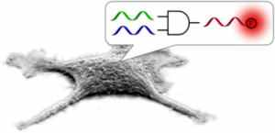
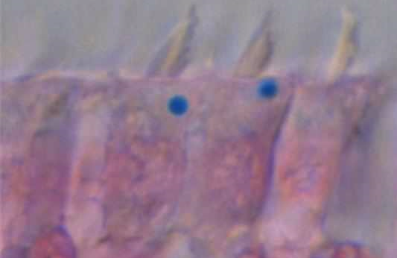
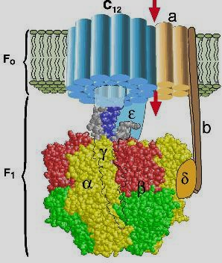
Incredibly Advanced Nanomachines, Nanocomputers, Digital Circuits, GPS & 3D Encryption in Cells Disprove Evolution
Credit: Image courtesy of North Carolina State Univ. [578]
(Credit: IMP) [588]

Slide 47
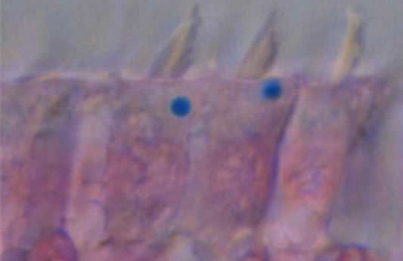
Incredibly Advanced GPS in Cells Disproves Evolution
Figure: Sensory neuron Hair Cells from the inner ear of pigeons stained with a chemical that turns iron bright blue in colour. (Credit: IMP) [588]

Slide 48
Incredibly Advanced GPS in Cells Disproves Evolution
Birds, Fish and Turtles Migrate Worldwide Using Cellular GPS Sensors and Magnetic Maps Preprogrammed Into their Brains at Birth
"... Discovery of iron balls in sensory neuron… in the ear are responsible for detecting sound and gravity. Remarkably, each cell has just one iron ball… in every bird…'but not in humans.’" [587]
“… Some animals possess internal GPS systems… able to read small variations in the intensity of Earth’s magnetic field and use that to guide them to their destination." [588]
"This describes a very complex 'computer' program using more than three variables! But note a critical element: the bird (fish, turtle or other animal) often has a magnetic 'map' (called the 'learned model') programmed into its brain, and follows this map to its destination.” [588]

Slide 49
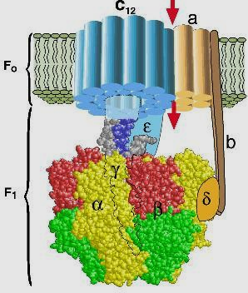
Incredibly Advanced Nanomachines in Cells Disproves Evolution
Videos - ATP Synthase Nanomotors
http://www.youtube.com/watch?v=PjdPTY1wHdQ
www.youtube.com/watch?v=J8lhPt6V-yM&feature=player_embedded
en.wikipedia.org/wiki/ATP_synthase

Slide 50
Incredibly Advanced Nanomachines in Cells Disproves Evolution
9mm ATP Synthase is analogous to the alternator in a car engine that turns by chemical reaction to create a mechanical force to turn a crank that produces electrical power to charge the car battery. [108]
Incredibly, F0 and F1 ATP Synthase are also reversible rotary motors. [108]
ATP Synthase is extremely advanced with electrical and bioengineering designs impossible to exist randomly in first cells on Earth 3.8 billion years ago in Cyanobacteria, (blue green algae).
No evolutionary time window exists from the 1st proven solid rocks that appeared at virtually the same time, 3.8 billion years ago.

Slide 51
Digital Logic AND Gate in DNA
“In DNA computing,... gates are created by combining different strands of DNA, rather than a series of transistors..." [578]
Figure: "Representation of a Boolean AND gate within a living cell.”
Credit: Image courtesy of North Carolina State Univ. [578]
“Computer operations utilize different inputs to create a particular output, ... (a cellular) DNA-based Boolean logic (AND) gate was activated only when both (microRNA) ... "inputs" (were) present in cells... the gate generated (a digital) "output" by releasing a fluorescent molecule." [578]

Slide 52

Image Encryption using DNA
“Instead of using traditional computer hardware, ... (researchers) created a computing system using bio-molecules.” [366]
Figure: “the scientists (bio) encrypted (combined) the Scripps Research and Technion logos on a single DNA chip (left) and, using software, decrypted (separated) the ... (individual) fluorescent images (at right).”
Credit: Image courtesy of Keinan lab [366] .

Slide 53
Image Encryption using DNA
.
“Every one of us is a biomolecular computer, a machine in which... molecules 'talk' to one another logically” [366].
"Various small DNA molecules are mixed in solution with selected DNA enzymes and ATP. The latter is used as the energy source...” [366].
“a wealth of information can be stored and encrypted in DNA molecules. Although each computing step is slower than the flow of electrons in an electronic computer, the fact that trillions of such chemical steps are done in parallel makes the... process fast. [366].

Slide 54

Creation in Lab Requires Design
[546]
Videos - Future Instant Printed 3D Human Organs Resemble Instant Bible Creation
www.youtube.com/watch?v=80DhBLEhdzk (Future Printed Organs)
www.youtube.com/watch?v=9D749wZSlb0 (Future Printed Organs)
www.youtube.com/watch?v=4WYKgjW9DmM
www.youtube.com/watch?v=DiY45jALWjE (3D Face Scanning)
www.youtube.com/watch?v=sH9KCHiuu8E (Make Tiny Non-Functional Brain)

Slide 55
Creation in Lab Requires Design
Researchers reproduce very simple examples of instant creation in the lab today using 3D bio-printing, that requires intentional engineering design, disproving random accidental evolution.
Engineers use 3D printing and scanning to build 3D moving machines nearly instantly in the lab.
Researchers use adult human stem cells in a 3D bio-printer to make a tiny piece of a non-working brain or a piece of a human blood vessel.
Researchers start with stem cells designed by God that can already develop into a complete fully functional brain by themselves.

Slide 56

Chemotherapy, Stable Metamorphosis, DNA Breakpoints and Extreme Natural Environments Disprove Macroevolution

Slide 57
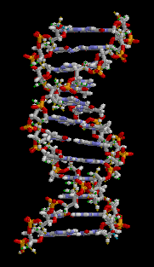
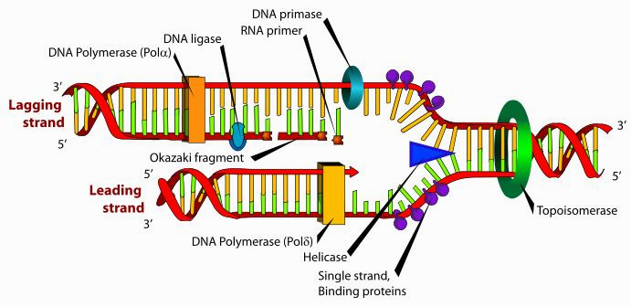
DNA Breakpoints Disprove Macroevolution

Slide 58
DNA Breakpoints Disprove Macroevolution
Some non-essential sections of RNA and DNA are designed with specific break points that allow small variations to occur at those locations with far greater frequency.
Break point DNA variation allows helpful small variation that provides individuality that includes: skin color, eye color, hair and fur color and patterns, body size, voice, fingerprints, etc.
This necessary small variation allows a baby buffalo for example to recognize it’s mother in a large herd of buffalo.
But, amazing unchanged stability (or stasis) can occur over hundreds of millions of years in sections of DNA code, not at breakpoints and critical to survival, as well as DNA needed an organism to remain “after their kind” as the Bible described. This is due to far more rigorous error checking of these critical sections.

Slide 59


Stable Metamorphosis Disproves Macroevolution
Frogs, 250 million years ago (figure left), have changed only slightly from frogs today (right).
This shows incredible fossil stability for one of the most common creatures on Earth, that undergoes several complete drastic body changes in each generation. [533]
Figure: 250 million year old Salientia frog. [533] Frogs today

Slide 60
Stable Metamorphosis Disproves Macroevolution
150 years of evolution research has only proved what the Bible said. That animals can produce other animals “after their kind” with small variations. [1][12]
Science shows the first animals of each “kind” appeared on Earth in an instant, fully formed, with no proof of anything before or after evolving by random collisions of atoms into any radically new or more advanced kinds.
Figure: 250 million year old Salientia frog. [533] Frogs today

Slide 61
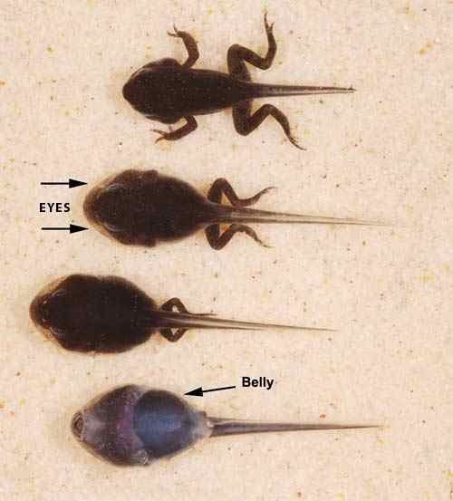
Stable Metamorphosis Disproves Macroevolution
Tadpoles completely change their body from egg, to tadpole with gills that breathe underwater like a fish and tail to swim and eat plants.
They change again into land frogs with lungs to breathe air and legs for hopping, plus a new digestive system to eat bugs.
A frog never turns into a dog. The same precise body changes occur over and over, billions of times, with the same results.
Figure: Repeatable frog metamorphosis. [533]

Slide 62
Chemotherapy Disproves Evolution
Chemotherapy and Radiation Cancer Treatments Disprove Accelerated Evolution Rates Evolutionists Claim Produced all Life
Harsh mutating radiation and chemotherapy treatments kill cancer cells or cause harmful DNA mutations that stop tumor cells from reproducing.
Cancer radiation treatments should produce the perfect conditions to reproduce instant evolution, but we find nothing!
We have immense test data from millions of people in top hospitals worldwide over decades, using repeated chemo and radiation treatments on trillions of cells in each person's body.
But, no more advanced or different new “kinds” of lifeforms appear that are self-replicating. No more advanced arms, heart, brain, eyes or ears pop out of mutated tumors or from radiation.

Slide 63
Extreme Natural Environments Disprove Instant Evolution
No new or more advanced “kinds” of lifeforms found in:
The 2011 Japanese Tsunami and Fukushima nuclear accident site.
Other nuclear accident sites or nuclear power plants, including Palo Verde that I visited while studying nuclear engineering.
Meteor Crater in Arizona that I visited while living in Arizona.
The Tunguska massive “air burst" meteor blast site in Russia.
Areas with many lightning strikes. Including a strike that killed a childhood friend.
The most massive volcanoes of modern history (Krakatoa, Novarupta, Pinatubo and Tambora); or Sunset Crater volcano and lava tube that I hiked in Arizona.
The Moon or Mars after decades of exploration by rovers, with liquid water present on Mars. [750]

Slide 64
Evolution and Creation are Mutually Exclusive, Disproving Evolution
The Bible stated that macroevolution cannot occur, from one kind to another.
  Can a fig tree... bear olive berries? Either a vine, figs? So can no fountain both yield salt water and fresh. (James 3:12)
The Bible refutes Theistic Evolution.
  God specifically stated that He made peacocks, ostriches, wings, feathers, eggs, the eye, the mouth and the ear (Job 39:13, Prov. 20:12). They were not random accidents.

Slide 65

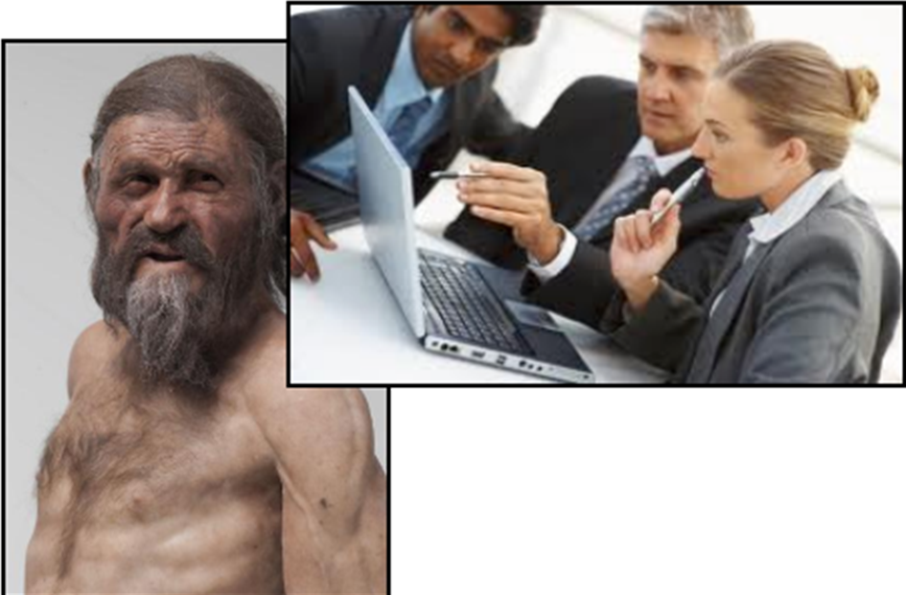
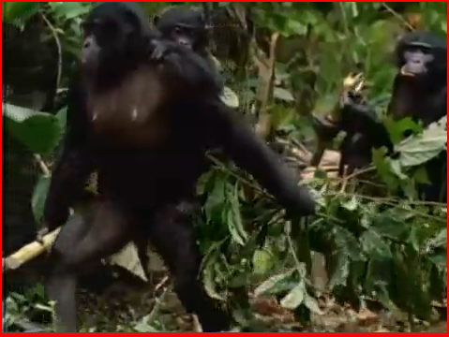
Iceman Ötzi and Bonobo Apes Disprove Macroevolution
Bonobo Apes Today [669]
Credit: South Tyrol Museum of Archaeology, modified photo Ochsenreiter [376].

Slide 66
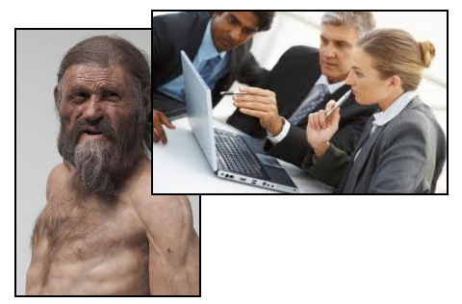
Frozen 5,300 Year Old Iceman Ötzi is Nearly Identical to Humans Today
Figure (left): Reconstruction of 5,300 year old Iceman Ötzi found with intact frozen real tissue, DNA, and organs.
Photo (right): Engineers today designing new advanced products,
compared to Iceman Ötzi's engineered designs.
Credit: South Tyrol Museum of Archaeology, modified photo Ochsenreiter [376].

Slide 67
Frozen 5,300 Year Old Iceman Ötzi is Nearly Identical to Humans Today
Iceman Ötzi is the oldest preserved 5,300 year old frozen modern human. He was found at 9,600 feet on a glacier between Austria and Italy. [376][433]
His preserved real tissue and DNA remains were extensively tested by 100 experts around the world for decades. [376][433]
The DNA and organs of Iceman Ötzi, (a Middle Eastern modern human), are nearly identical to DNA of people living today in Corsica and Sicily, by Italy. [376][433]
Iceman Ötzi had light skin, brown hair and brown eyes. He was 5 foot 5 inches tall with modern diseases (cardiovascular disease, lactose intolerance and Lyme disease).
His intact blood cells are nearly identical to humans today. [376][433]

Slide 68
Frozen 5,300 Year Old Iceman Ötzi is Nearly Identical to Humans Today
Iceman Ötzi had advanced engineered designs including:
A sewn leather belt.
A bear skin cap with chin strap, coat and leggings.
Waterproof shoes (from multiple sewn animal skins, that were wider at the bottom for use as mountain snowshoes).
Warm grass socks. [385][433]
Weapons:
99.7% pure copper ax, (smelted, cast, cold-forged, sharpened).
Arrows in a quiver pouch with advanced stabilizing fins.
A powerful 72 inch longbow. [385][433]
Tool belt pouch with:
Mushroom birch fungus, known as an antibacterial medicine.
A complex fire starting kit (with a 2nd type of mushroom for tinder and flint, plus pyrite for creating sparks). [433]

Slide 69
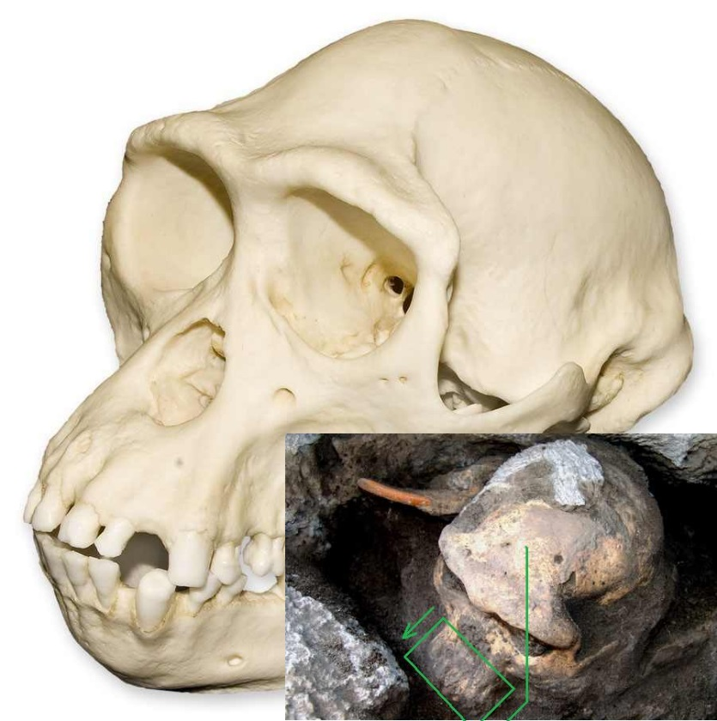

Science Proves Bonobo Apes are Nearly the Same as Homo Erectus Hominids
Bonobo ape skull today
The First Complete In Situ Skull of Homo Erectus Throws Human Evolution into Disarray [664]
Homo erectus hominid (ape)
[668]
[664]

Slide 70
Science Proves Bonobo Apes are Nearly the Same as Homo Erectus Hominids
.
"A haul of fossils found in Georgia suggests that half a dozen species of early human ancestor were actually all Homo erectus." [664]
"Anthropologists unearthed the skull at a site in Dmanisi,... Georgia, where other remains... dated to 1.8m years old." [664]
"Experts believe the skull is one of the most important fossil finds to date... scientists have been too ready to name separate species of human ancestors in Africa. Many of those species may now have to be wiped from the textbooks." [664]
“it would trim the base of the human evolutionary tree and spell the end for names such as H rudolfensis, H gautengensis, H ergaster and possibly H habilis." [664]

Slide 71

Science Proves Bonobo Apes are Nearly the Same as Homo Erectus Hominids
Bonobo ape skull today
Bonobo apes (top) greatly resemble the first complete in situ Homo erectus hominid skull (bottom) found in Dmanisi Georgia, with several complete bodies. [664]
Apes and hominids both have under 550 cc small brain volumes, with the same large protruding ape jaw and large chunky ape teeth. [664]
Far more intelligent top predator humans have nearly 3X this brain size, with 1300 cc brains. [664][674][170]
Homo erectus hominid ape
[668]
[664]

Slide 72
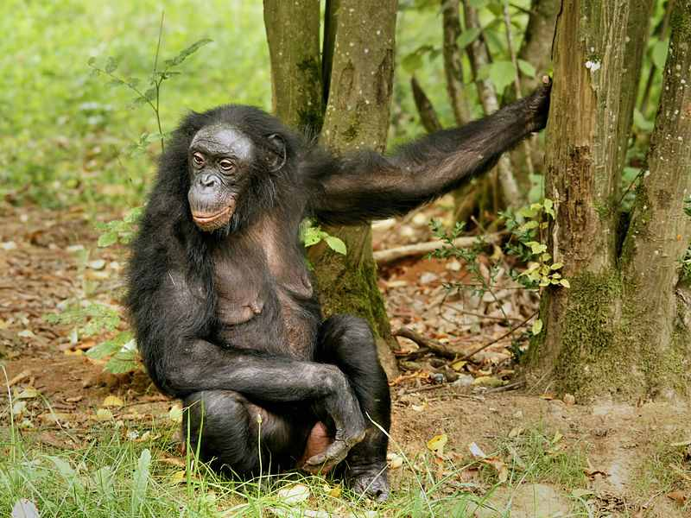
Science Proves Bonobo Apes are Nearly the Same as Homo Erectus Hominids
Bonobo Apes Today and Extinct Homo Erectus Both:
Were short 3.5 foot prey animals, eaten by carnivores [664]
Climbed trees and walked upright occasionally [667][669][674]
Ate fruit and had no large canine teeth [153]
Had fast growing independent mobile babies right after birth, similar to other prey animals including deer. [146][627][667]
Photo (left & right): Bonobo Ape walking today [669]

Slide 73
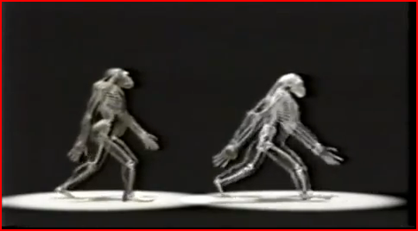

Science Proves Bonobo Apes are Nearly the Same as Homo Erectus Hominids
Video: Extinct Homo Erectus Hominids Greatly Resemble Occasionally Upright Walking Tree Climbing Bonobo Apes Today
www.youtube.com/watch?v=3Sjkv29k3cw
3.5 foot tall homo erectus ape [670] [668]
3.5 foot tall bonobo ape today [670] [668]
[669]
[670]

Slide 74
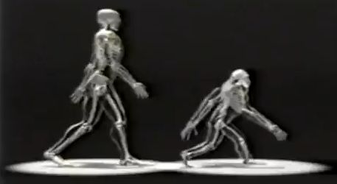
Science Proves Bonobo Apes are Nearly the Same as Homo Erectus Hominids
Occasionally upright walking 3.5 foot tall bonobo ape today
Upright walking modern human
[670]
Research proves that apes and humans have a massive 6% different DNA ≈ 180 million differences. [ 154][674]
Apes have 1 more chromosome pair 24, plus 1/2 billion more DNA. [ 154][674][751]
Humans have 3X larger brains, far more brain wrinkling and brain organ specialization.
Humans have a smaller birth canal with helpless human babies that require a decade longer motherly care and adolescent brain growth to acquire wisdom, scientific learning, art and social skills. [20][144][160][626][627] [674]

Slide 75


DNA Differences, Improved Radio Carbon Dating, Mule Breeding, Continent Barriers & Prototypes Prove Neanderthals Didn’t Evolve into Humans
Evolution Is Not Science, Jeff Woodward

Slide 76
Very Different mtDNA & Nuclear DNA Proves Neanderthals Didn’t Evolve into Humans
Five previous mtDNA studies (including Svante Pääbo's) prove Neanderthals were NOT ancestors of humans. [605][618]
Neanderthal mtDNA doesn't closely match human mtDNA as is required for mtDNA, passed as exact copies from mother to child.
  Pääbo distracts us from this pesky fact by claiming Neanderthals interbred with humans… long AFTER fully formed humans instantly appeared, by means no one can explain.
Evolution Is Not Science, Jeff Woodward

Slide 77
Very Different mtDNA & Nuclear DNA Proves Neanderthals Didn’t Evolve into Humans
  Pääbo is refuted because after DNA testing worldwide, we find no required modern humans with pure Neanderthal or hominid mitochondrial mtDNA.
  Pääbo's theories are further disproved because rigorous science repeatedly shows the earliest humans in Europe were not Pääbo's erroneous “pure human” black Africans. They were white Mediterraneans, like Iceman Ötzi. [376][433]
  In Biblical scriptures, God specifically stated that no human animal mixing of any kind produced humans alive today. (Lev. 18:23-30)
Evolution Is Not Science, Jeff Woodward

Slide 78
Very Different mtDNA & Nuclear DNA Proves Neanderthals Didn’t Evolve into Humans
The number of DNA bases differs by one billion from Humans to Neanderthals.
Humans have three billion, chimpanzees have three and one half billion and Neanderthals have an estimated four billion. [154][618][624]
One billion DNA differences (25%) from humans to Neanderthals is not mentioned, or claimed to be junk DNA in Neanderthals.
But most former human junk DNA is now disproved in humans as we learn it’s true critical functions. [751]
“…The (highly unreliable) Max Planck Institute... and 454 Life Sciences … draft of the Neanderthal genome based on the analysis of four billion base pairs of Neanderthal DNA.” [624]
Evolution Is Not Science, Jeff Woodward

Slide 79
Improved Radio Carbon Dating Proves Neanderthals Didn’t Evolve into Humans
New much more accurate radiocarbon dating techniques correct large radiocarbon dating errors, due to bacterial and other contamination by Max Planck scientists in the past, while studying Neanderthal cave sites in France.
“This includes a hyena tooth pendant, a reindeer bone awl and other artifacts. The jewelry was tested to verify it was only 21,000 to 23,000 years old and therefore belonged to modern humans. This is too young to belong to Neanderthals that died out...” [21]
“The human jewelry became mixed in with the older disturbed Neanderthal bone remains when the Neanderthal dirt layers were dug up by modern human. [21]
The new information shows that Neanderthals did not suddenly become more intelligent and start wearing jewelry and making complex tools like modern humans.

Slide 80
Improved Radio Carbon Dating Proves Neanderthals Didn’t Evolve into Humans
Evidence shows Neanderthals died out 45,000 - 50,000 years ago, much earlier than previously thought. [17][21][383][609][619]
Extinct Neanderthals could not interbreed with humans.
Over 20 different rigorous independent dating methods* prove Neanderthals were extinct approximately 7 thousand years or more, before the first humans appeared on a different continent, 7,000 to 41,000 years ago. [17][21][383][609][619]
* In situ: tool dating, writing and pottery dating, tooth enamel dating, calcite cave deposit dating on bones, improved filtration carbon 14 dating, mtDNA mutation rate dating, cave artwork dating, nearby extinct animal bone dating, bat dropped seed dating, tree ring dating, frozen ice age dating and repeating ice age sea level rise dating that caused cave barriers.

Slide 81
Improved Radio Carbon Dating Proves Neanderthals Didn’t Evolve into Humans
The last few Neanderthals in the Iberian Peninsula (near northern Spain) [604] showed very little genetic diversity [611] and died out thousands of years before the first humans instantly appeared, fully formed, far away in the Middle East. [383]
“… Neanderthal occupation of the sites did not last until as late as previously thought; instead it should be placed approximately 45,000 years ago."[383]

Slide 82
Horse and Donkey Interbreeding Can't Produce a Self-Sustaining New Species
Horses and donkeys are similar and can mix to produce offspring. But mule offspring are sterile and can't naturally reproduce. None have produced a 2nd generation mule.
A horse and donkey must mix for every mule that is born. This is because horses have 2 more chromosomes than donkeys. [622]
Humans and genetically very different Neanderthals could not produce new offspring capable of reproduction of this new line.
When Neanderthals became extinct, any claimed mixed human Neanderthal offspring would be sterile and could not reproduce. Therefore, they would also become extinct after they died.
The same would occur for claimed human hominid offspring. When the hominids became extinct, their sterile offspring would become extinct. No human hominid mix could live today.
Evolution Is Not Science, Jeff Woodward

Slide 83
Required Engineering Prototype Designs Prove Neanderthals Didn’t Evolve into Humans
The first humans unbelievably built the Tower of Babel (taller that most modern city skyscrapers), the Great Pyramids and also Noah's Ark (a boat one half the size of the Titanic).
Clearly this was very different from tree climbing hominid apes and strong but relatively unintelligent, unspeaking Neanderthals, with far less brain wrinkling. [169]
Credit: South Tyrol Museum of Archaeology, modified photo Ochsenreiter [376].
Evolution Is Not Science, Jeff Woodward

Slide 84

Required Engineering Prototype Designs Prove Neanderthals Didn’t Evolve into Humans
Medical researchers for safety extensively test new medicines on mice, pigs or monkeys for years before testing them on humans.
Engineering methodology requires Validation and Verification (V&V) testing of each new complex system design and prior testing of small quantities of a similar prototype design to verify a new complex system design will perform as planned and is safe.
This book proves that God was the master engineer who intentionally engineered all life on Earth following proven engineering design methodology.
Evolution Is Not Science, Jeff Woodward

Slide 85
Required Engineering Prototype Designs Prove Neanderthals Didn’t Evolve into Humans
Because God is perfect, He would build a prototype. A prototype leads to perfection.
Some critics state that God who is perfect didn’t need to build a prototype. But, building a prototype is the standard practice for engineers to build a final design as close to perfection as possible.
(Hypothesis): I believe that God created a few early Neanderthal animals without souls to be prototypes for the later introduction of billions of modern humans on Earth. [2]
After prototype testing was complete, God no longer needed this small population of test animals and allowed them to die out and become extinct.
Evolution Is Not Science, Jeff Woodward

Slide 86

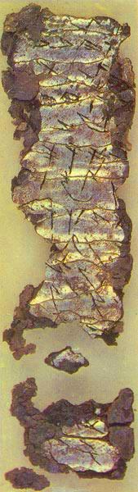
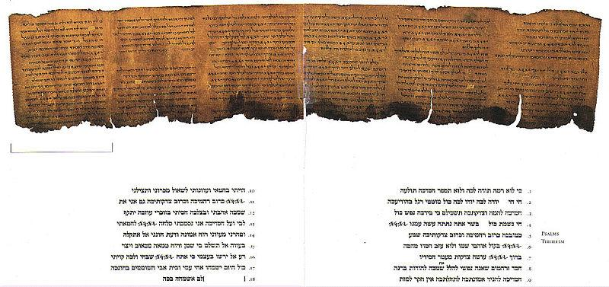
Archaeology Proves the Literal Bible
[286]
[35]

Slide 87
Archaeology Proves the Literal Bible
The Ketef Hinnom Scrolls made of silver and inscribed with a Priestly Blessing from the Bible is dated to before 586 BC (2,600 years old). [286].
"The 2004 team described the scrolls as 'one of most significant discoveries ever made' for biblical studies...” [287])
The (2,600 year old) scrolls "preserve the earliest known citations of texts also found in the Hebrew Bible … concerning Yahweh (ancient Hebrew name of God).” [287])

Slide 88
Archaeology Proves the Literal Bible
The 2,200 year old Dead Sea Scrolls (with all Old Testament books)[35][278], plus the most accurate Majority Text (Greek Byzantine Received Bible) and most accurate King James Bible, show remarkably few significant differences. [240][274][275][279][280]
A few differences include: verses out of order, commas, mistranslations, words deleted and italic words added. [35][239][240][241][279][280]

Slide 89
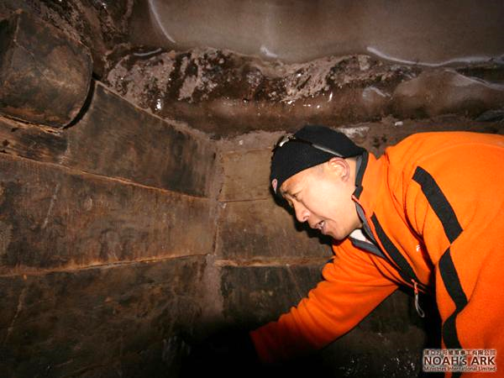
Archaeology Proves Bible is Literally Correct
Archaeology Proves the Literal Bible
The multinational exploration team from NAMI inside Noah’s Ark encased in glacial ice on Mount Ararat. [138]

Slide 90
Archaeology Proves the Literal Bible
They videotaped the entire exploration of the Ark as they repelled fifty feet down into an ice crack to find several rooms with heavy wooden floors, stalls and walls with massive ancient wooden planks extending deep into solid ice. [30][31]
They repelled down two other similar ice cracks up to 300 feet away and found similar heavy wooden beams and heavy old ropes. They found tenons used to hold planks together on ancient boats before nails were used. [30][31]

Slide 91
Archaeology Proves the Literal Bible
Seven (Ark) spaces revealed [138]
  “There is tenon construction on the wall…”
  “This space stands at more than 5 meters (16.4 feet) high… and the walls are not vertical but rather curved and inclined.”
  “There is a wooden beam with wooden nails... It is believed that a rope was hooked on these nails to keep animals in place… there are racks.”
  “A few wooden staircases were found inside the structure…”
“The team brought samples of the wood back for carbon testing. It was tested to be at least 4800 years old. Some of this 4800 year old wood is now petrified.” [30][31]
This agrees closely with the Bible that described Noah on the Ark 5,061 years ago.

Slide 92
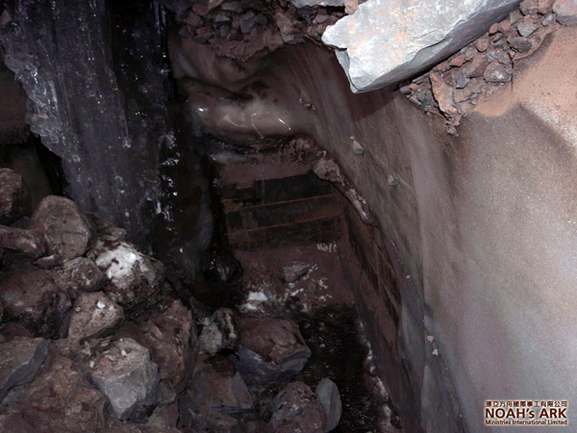
Archaeology Proves the Literal Bible
[138]

Slide 93
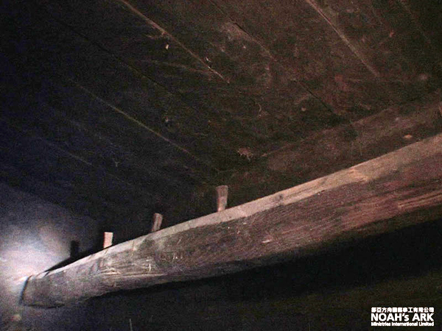
Archaeology Proves the Literal Bible
[138]

Slide 94
Archaeology Proves the Literal Bible
Video - Noah's Ark Found on Mt. Ararat 2009
www.youtube.com/watch?v=NHaOSUyM7-Y (Raw video, ark exploration)
www.youtube.com/watch?v=vl8J9MUeJWo (Raw video, ark exploration)
www.youtube.com/watch?list=PL9B78C57FB3778445&v=Cc7lLKCDwrw
www.cbn.com/cbnnews/world/2010/April/Explorers-Claim-They-Have-Found-Noahs-Ark
www.wnd.com/?pageId=146369
https://en.wikipedia.org/wiki/Searches_for_Noah%27s_Ark

Slide 95
Dinosaurs Were Accurately Described First in the Bible
Evolutionists state that dinosaur bones prove God didn't create the world. But, the truth is exactly the opposite. Dinosaur bones prove the Bible was literally correct.
God told us that he created dinosaurs in the book of Job, one of the oldest books of the Bible, thought to be 4,000 years old. [91]
God described the dinosaurs to Job with scientifically accurate detail. But the Bible NEVER stated that dinosaurs died in the flood of Noah. These great beasts didn't exist at the time of Job.
The Bible only states that dinosaur creatures called leviathans and behemoths existed at some point in Earth's past history. (Job 40:15-23 and 41:1-34)
Science discovered dinosaur bones about 2,000 yrs. later and discovered that dinosaurs exactly match the Bible descriptions.

Slide 96
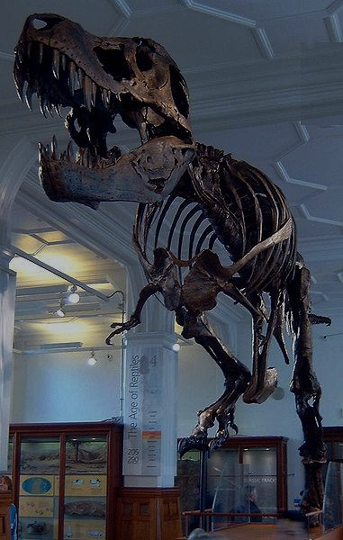

Dinosaurs Were Accurately Described First in the Bible
God tamed these great Leviathans with their terrible teeth roundabout like pet birds. They had tough skin and a strong neck. Iron spears, arrows and swords were like straw and stubble to this fearsome Leviathan... None is so fierce that dare stir him up. He is a king. (Job Ch. 41)
This is an accurate description of the Tyrannosaurus Rex that scientists today show did have a few similarities to birds.
But they are very different, independent and unique from birds in many other aspects, including very heavy non-flight bones, heart, lungs and brain design. [180]

Slide 97
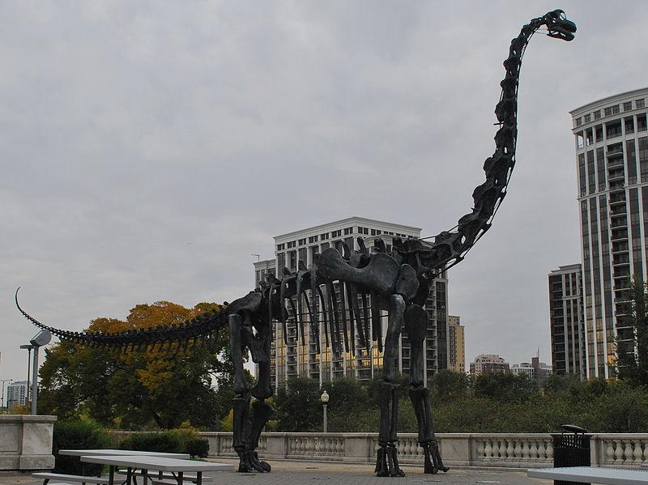
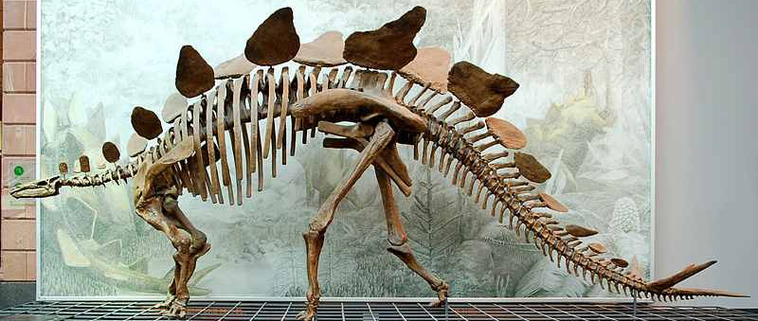
Dinosaurs Were Accurately Described First in the Bible
The Bible accurately described giant plant eating dinosaurs called Behemoths. God said these great Behemoths ate grass and had massive tails as round as Cedar trees. They had bones like bars of iron. They could drink up the Jordan River and had chests as hard as rock and many shields on their back. (Job 40 and 41)
Behemoth

Slide 98
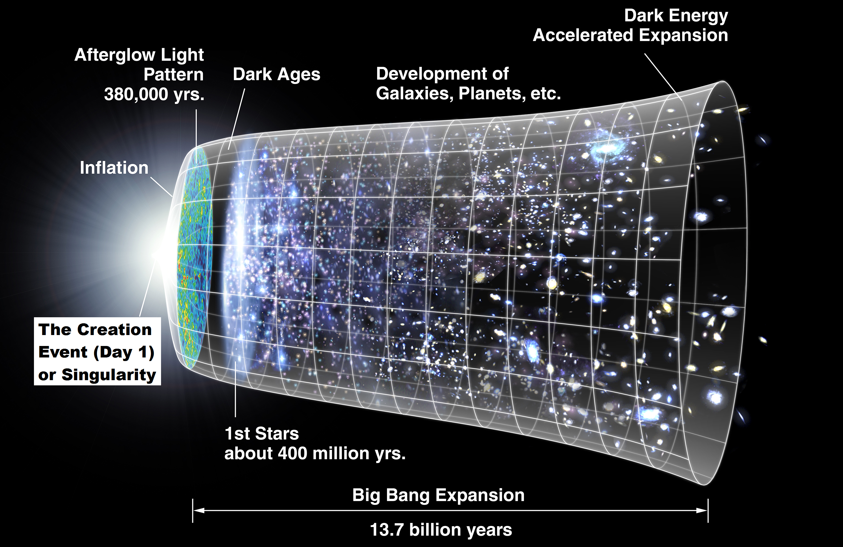
Evolution Violates the 1st and 2nd Laws of Thermodynamics and the Big Bang
The Big Bang Expansion (modified NASA drawing [370])

Slide 99
Evolution Violates the 1st and 2nd Laws of Thermodynamics and the Big Bang
  Science proves the Big Bang was an incredibly powerful, precisely controlled cosmic “expansion” (not an explosion) from a near infinitely compact hot starting point to release all matter, energy, space and time. [3][4]
  Science has incredibly accurate verifiable data from many independent sources to support the Big Bang Theory. [3][4]
  The cosmic background radiation is still observable today, looking back in time through microwave telescopes.
  The further the distance in space that we observe, the hotter the Big Bang event background radiation. [3][4]

Slide 100
Evolution Violates the 1st and 2nd Laws of Thermodynamics and the Big Bang
The Big Bang Theory is proved with further certainty by many independent measurements producing approximately the same linear time date for the Big Bang. [3][135][319]
The Red Shift of light [331]
U238 dating [289]
Higher amounts of Big Bang event helium in distant dust clouds. The further back in time we look the more helium we see. [3]
12 to 13 billion year old burnt out white dwarf stars at the edge of the universe. [318]
For decades evolutionists fought against the Big Bang Theory because Darwin erroneously believed that the universe was in an eternal steady state, with no beginning or end, and that the universe never changed or expanded. [3][4][135]

Slide 101
Evolution Violates the 1st and 2nd Laws of Thermodynamics and the Big Bang
The First Law of Thermodynamics
States that energy cannot be created or destroyed. Energy cannot spontaneously appear from absolutely nothing. [3][12]
Energy can only change from one form of energy to another. [3][12]
Creating the entire universe from the Big Bang required the creation of massive amounts of new energy and matter with unimaginable levels of complexity and low entropy symmetry.
Evolution Is Not Science, Jeff Woodward

Slide 102
Evolution Violates the 1st and 2nd Laws of Thermodynamics and the Big Bang
The 2nd Law of Thermodynamics
Requires everything to start from a higher ordered state and progress to a lower ordered more random state. The reverse is impossible unless acted on by an outside force.
Evolution violates the 2nd Law of Thermodynamics and required perpetual state of entropy and decay throughout the universe.
Evolution is another cleverly disguised illegal perpetual energy machine with reverse entropy.
Evolution illegally requires matter to accidentally go to higher energy levels, with impossible levels of information and complexity, to form trillions of interacting cellular nanomachines and nanocomputers in a single animal.
Evolution Is Not Science, Jeff Woodward

Slide 103
Evolution Violates the 1st and 2nd Laws of Thermodynamics and the Big Bang
After decades working with nearly every software code, I have never observed software mutate into a more advanced code by accident or by repeated copying over a long time.
Software code also follows the rule of entropy until software becomes useless unreadable junk due to: copy and read errors, dissipated tape magnetism, crashed drives, scratched CDs, ESD, moisture, humidity, thermal stress, etc.
Similar to software code, DNA is proven to degrade very slowly over time, following the required rules of entropy.
DNA degradation is slowed by DNA repair machinery. This is the definition of a machine that does intentional work when supplied fuel, with expelled exhaust byproducts.
Evolution Is Not Science, Jeff Woodward

Slide 104
Evolution Violates the 1st and 2nd Laws of Thermodynamics and the Big Bang
Invisible Dark Matter, the Bible Described it First
The Bible said the universe was created by God from something “invisible” that we cannot see or detect.
“… The universe was formed at God’s command, so that what is seen was not made out of what was visible.” (Heb. 11:3 NIV)
God and his power are also described as invisible in Rom. 1:20.
Science is finding what the Bible described, dark energy and matter that are “invisible” yet make up 96% of the mass of the universe. The mass is caused by an invisible Higgs ocean.
This invisible cosmic web of dark matter is used to pull stars and galaxies and bind them in optimal pre-planned locations as described by God in Job 38:31
Evolution Is Not Science, Jeff Woodward

Slide 105

Evolution Violates the 1st and 2nd Laws of Thermodynamics and the Big Bang
“The Herschel Space Observatory has revealed how much dark matter it takes to form a new galaxy… dark matter, an invisible substance permeating our universe, contributed to the birth of massive galaxies…” [346]
'If you start with too little dark matter… (a) developing galaxy would peter out", "If you have too much, then gas doesn't cool efficiently to form one large galaxy… you end up with lots of smaller galaxies'“. [346]
Figure: White = gravitational lensing of starlight behind dark matter (Credit: Van Waerbeke, Heymans & CFHTLenS) [346].
"Astronomers … mapped dark matter on the largest scale ever observed. New findings reveal a Universe comprising an intricate cosmic web of dark matter and galaxies spanning more than one billion light years." [346]

Slide 106
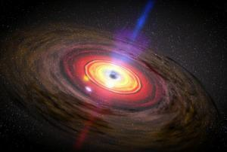
This Century's Greatest Astrophysics Discoveries Reveal God
The Anthropic Principle's 200 Unimaginably Fine-Tuned Characteristics
Figure: In the center of a whirlpool of hot gas, a black hole is shown accreting a cloud of dust and gas, (Credit NASA artist).
Evolution Is Not Science, Jeff Woodward

Slide 107
This Century's Greatest Astrophysics Discoveries Reveal God
The Anthropic Principle's 200 Unimaginably Fine-Tuned Characteristics
The Anthropic Principle shows that creation of the entire universe for life on Earth to exist, required fine tuning to unimaginably precise degrees of over 200 characteristics. [3][4]
If any one of these 200 characteristics was minutely altered, life on Earth would not be possible. [3][4]
“The probability that all this astrophysical complexity and fine tuning could occur in the universe accidentally by evolution and chance is one chance in 1X10 ²⁵⁰ . Therefore evolution is statistically impossible”. [3][4]
Evolution Is Not Science, Jeff Woodward

Slide 108
This Century's Greatest Astrophysics Discoveries Reveal God
“Incredible fine tuning of one part in 1X10¹²⁰ is required for the Space Energy Density expansion rate of the universe, or life could not exist on Earth”. [3][4]
If the number of stars in the universe of billions of trillions of stars was any more or any less, the universe would contain only helium and hydrogen with no stars or contain only heavy elements like iron and black holes. Life on Earth would not be possible [3][4].
“Only spiral arm galaxies can support life, and only 6% of the galaxies in the universe have spiral arms…” [3][4]
“The black hole at the center of our galaxy must be exactly the right size and shape for life to exist on Earth. If too large, we would be bombarded with deadly radiation and gravity... If too small, we would not receive enough heavy elements …” [3][4]
Evolution Is Not Science, Jeff Woodward

Slide 109
This Century's Greatest Astrophysics Discoveries Reveal God
Videos - Creator and the Cosmos and Journey towards Creation
https://www.youtube.com/watch?v=IayzEWA_o8g
www.reasons.org/resources/news-archive
Videos - Privileged Planet
www.youtube.com/watch?v=HtjyUElU6n0&feature=endscreen&NR=1
www.youtube.com/watch?feature=endscreen&NR=1&v=MQQm_H7Eo8A
www.youtube.com/watch?v=gJ_lTrTSXuk&feature=endscreen&NR=1
www.youtube.com/watch?v=-mdjM4-gRGg&feature=relmfu
Evolution Is Not Science, Jeff Woodward

Slide 110
This Century's Greatest Astrophysics Discoveries Reveal God
“The early Earth's plant life, Cyanobacteria and seaweeds, further terraformed the atmosphere into the life sustaining oxygen atmosphere we see today”. [4][86][109]
“We now know that every single year of the billions of years of Earth's formation was necessary for the Earth's safe habitation by man today. Every organism that was needed for this predetermined design process was introduced by God at the exact moment the Earth was able to support it”. [2][3][4]
“The probability that all this astrophysical complexity and fine tuning could occur in the universe accidentally by evolution and chance is one chance in 1X10 ²⁵⁰ . Therefore evolution is statistically impossible”. [3][4]
Evolution Is Not Science, Jeff Woodward

Slide 111
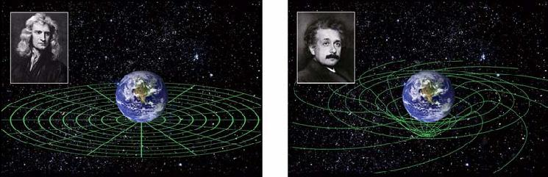
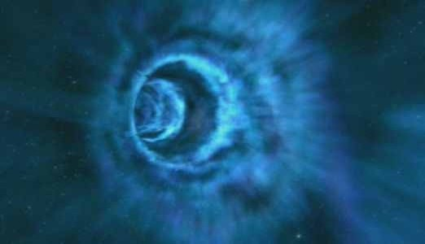
The Bible Provides Clues About Time & Space Beyond Science Today

Slide 112
The Bible Provides Clues About Time & Space Beyond Science Today
Video: Einstein Stated that Time was an Illusion
http://youtu.be/VYZQxMowBsw
Figure: Space-time fabric twisting like honey swirling around Earth. [137][290]

Slide 113
The Bible Provides Clues about Time & Space Beyond Science Today
Young Earth Creationists state that we must throw out most of rigorously provable science that agrees with the literal Bible.
Young Earth Creationists add words to the Bible that claim the universe is only 6,000 years old. But these “literal” words cannot be found in the Bible.
Jesus never stated the Earth was young, or stated the age of the universe, or described dinosaurs living with Adam, or stated that space and time were simple.
Jesus demonstrated examples of the incredible complexity of space and time by changing to a brilliant transcendence on a mountain while talking with Moses, Elijah and God.
Jesus also entered a room through locked doors to speak to the apostles, and disappeared while eating with others.

Slide 114
The Bible Provides Clues about Time & Space Beyond Science Today
Young Earth creationists change the Bible's words to fit their predetermined assumption that time was simple and linear.
The Bible never stated that Genesis human genealogies must be added to the seven 24 hour days of creation to calculate the total age of the Earth and universe.
Christians have ASSUMED this, but the Bible does not specifically say this.
Many Christians including Pat Robertson are now refuting Catholic Archbishop Ussher's (in year 1654) calculation of approximately 6,000 years for the age of the universe. [707][717]
Pat Robertson states this “is just nonsense”... “The dating of Bishop Ussher just doesn't comport with anything that is found in science”. [706]

Slide 115
The Bible Provides Clues About Time & Space Beyond Science Today
Time can slow down or speed up, due to velocity. The most accurate laser clocks on orbiting GPS satellites at high velocity record time slightly slower than time on Earth. [291]
The time your brain experiences is slightly different than the time observed at your toes, due to different elevations above the Earth. [290]
Science shows that every point in the universe experiences time at a slightly different rate, due to relativity and slight differences in gravity and velocity. [290]
The Bible described nonlinear time thousands of years ago.

Slide 116
The Bible Provides Clues About Time & Space Beyond Science Today
Many Bible Verses Describe how God can Accelerate Time, Make Time Stand Still and Reverse Time
One day is with the Lord as a thousand years, and a thousand years as one day. (II Peter 3:8)
The Bible said that both the Sun and Moon stood still in the sky about an entire day for Joshua. (Joshua 10:10-14)
God stated that He could see the end from the beginning.
The Bible stated that God existed before the universe and before time. God always existed and had no beginnings and will have no end. (Rev. 21:4-6)
God exists outside of time. [2][3][4]

Slide 117
The Bible Provides Clues About Time & Space Beyond Science Today
Hezekiah’s Illness
“This is the LORD'S sign to you… I will make the shadow cast by the sun go back the ten steps it has gone down on the stairway of Ahaz (a sundial per the KJV)”. So the sunlight went back the ten steps it had gone down. (Isaiah 38:7-8)
Time isn’t linear and had a beginning, science is proving this.
People with near death experiences report seeing all different times at once when visiting heaven, or time has no meaning. Other people return to their body in seconds per hospital clocks, but patients say they were away a long time.

Slide 118
The Bible Provides Clues About Time & Space Beyond Science Today
Wormholes: The Bible Described them First
Timeless wormholes are described in both the ancient Bible scriptures and the most advanced science today.
This is also consistent with the tunnel of light many people with near death experiences report traveling through.

Slide 119
The Bible Provides Clues about Time & Space Beyond Science Today
Quantum entanglement and Big Bang Theory show that every particle in the universe is connected to every other particle in a space-time fabric “curtain”, as the Bible described. (Isaiah 40:22)
It is he that sitteth upon the circle of the earth, and the inhabitants thereof are as grasshoppers; that stretcheth out the heavens as a curtain, and spreadeth them out as a tent to dwell in (Isaiah 40:22).
“The early universe began with a huge amount of space curvature (a folded curtain) and little or no matter. But, as the universe expands, space is stretched, reducing the curvature. This loss of curvature (resembling an opened nearly flat curtain today) is transformed into matter...” [4]

Slide 120
The Bible Provides Clues about Time & Space Beyond Science Today
Physicist Finds (Quark) Entanglement Instantly Gives Rise to a Wormhole
“Earlier this year, physicists proposed an answer in the form of ‘wormholes,’ or gravitational tunnels. The group showed that by creating two entangled black holes (using vacuum captured quarks), then pulling them apart, they formed a wormhole -- essentially a ‘shortcut’ through the universe -- connecting the distant black holes.” [681]
“The theoretical results bolster the relatively new and exciting idea that the laws of gravity holding together the universe may not be fundamental, but arise from something else: quantum entanglement.” [681]

Slide 121
The Bible Provides Clues about Time & Space Beyond Science Today
The Bible States that Time and Space were Far More Complex than Imagined
Isaiah, Stephen and John the Apostle all described an instant doorway to a very near heaven that opened up in front of them while they were still on Earth. (Acts 8:55-57, Isaiah 6, Rev. 4:1-2)
After this I looked, and, behold, a door was opened in heaven: and the first voice ... said, Come up hither, and I will shew thee things which must be hereafter. And immediately I was in the spirit: and … a throne was set in heaven… (Rev. 4:1-2)
As they traveled along the road, they came to some water and the eunuch said, “Look, here is water. What can stand in the way of my being baptized?”... When they came up out of the water, the Spirit of the Lord suddenly took Philip away, and the eunuch did not see him again, but went on his way rejoicing. Philip, however, appeared at Azotus and traveled about, preaching the gospel... (Acts 8:26-40 NIV)

Slide 122
The Bible Provides Clues about Time & Space Beyond Science Today
God created the entire universe in seven consecutive twenty four hour literal days as the Bible stated. But God is not limited to travel our simple linear time path.
The timeless wormhole path (“door … in heaven”, Rev. 4:1-2) that God traveled during transcendent creation, determined the total time of seven consecutive twenty four hour days that God experienced during creation.
But both time paths, seven days and 13.75 billion years, still exist simultaneously. Therefore, the universe is both young and old at the same time.
But there were no conscious beings that experienced the full time path of 13.75 billion years of the universe during creation. Therefore, this time path is not valid.

Slide 123
The Bible Provides Clues about Time & Space Beyond Science Today
This is analogous to different time paths that exist simultaneously while watching a DVD movie. If you fast forward ahead on that DVD, the total time to watch a movie is only a few minutes and is determined by the nonlinear path the laser takes on the DVD.
The full DVD time path still exists, but is not a valid time path, because no one was there to experience it.
This is similar to a tree that falls in a forest. It makes no audible sound, until there is a person there to hear it.
Per the Bible, Adam was also created young and old at the same time. He was created in moments. But, per scientific instruments his age would be that of an adult.

Slide 124
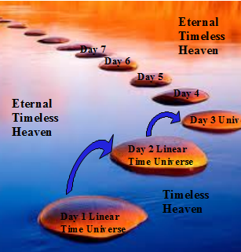
The Bible Provides Clues about Time & Space Beyond Science Today
During creation, timeless God transcended into our linear time universe at only the discrete time points needed for creation.
God, who can control time per the Bible, would not inefficiently wait around through millions of years until the next creation step.
The next rapid design bursts occurred on the next creation day, at different points in time, with long periods of stasis between each design burst. This matches what we find in the scientific record.
If we add up the total time “slices” (that science now describes), [374] for each rapid design burst, through 13.75 billion linear years of the universe, we come up with an estimate of six consecutive 24 hour days of work by God, exactly as the Bible described.

Slide 125
The Biblical Creation Sequence Matches All Rigorously Proven Science - After Scientifically Illegal Evolution is Thrown Out
[669]
[533]
[137]
[376].

Slide 126
The Biblical Creation Sequence Matches All Rigorously Proven Science - After Scientifically Illegal Evolution is Thrown Out
Day 1 the Big Bang, The First Light in the Universe Matches the Bible
“(Science shows) there was a blinding flash of “light” 1 millionth of a second after the Big Bang event as matter and antimatter throughout the universe collided and was eliminated.” [3]
The First Galaxies, Stars and Planets
After the Big Bang the entire early universe was a blurry glowing plasma (light), that began to separate into early galaxies and stars with “light divided from the darkness” for the first time.
The first galaxies, stars and planets began as “dark formless” clumps of dust, gas and dark matter. When the mass and temperature reached the ignition point, stars began to shine in a “dark” universe. [3][4][135]

Slide 127
The Biblical Creation Sequence Matches All Rigorously Proven Science - After Scientifically Illegal Evolution is Thrown Out
This matches what the Bible said, word for word
In the beginning God created the heaven and the earth.
And the earth was without form, and void; and darkness was upon the face of the deep...
And God said, Let there be light: and there was light.
And God saw the light, that it was good: and God divided the light from the darkness (Genesis 1:1-4).

Slide 128
Biblical Creation Sequence Proven by Identical Gaps in: Fossils, Real Tissue Samples & mtDNA
This is Proven By:
Incredible 250 million year old fossil stability (or stasis) is found in many advanced organisms including: sharks, Coelacanth fish, Lungfish, jellyfish, dragon flies (swamp flies), flowering trees, ferns, frogs, cyanobacteria (blue green algea) and scorpions.
Independent identical massive fossil gaps between each different “kind” of organism are found in independent rock fossils, frozen tissue samples and mtDNA.
[376].

Slide 129
Biblical Creation Sequence Proven by Identical Gaps in: Fossils, Real Tissue Samples & mtDNA
Extensive research of monkeys, Neanderthals, hominids and every different kind of bird using frozen preserved REAL bone, soft tissue and real DNA independently confirm the exact same massive feature gap results as found in traditional mineralized rock fossils.
We find discontinuous independent but similar looking organisms that all appeared instantly fully formed and complex without any transitional forms before or after.
This is independent proof that the gaps in the fossil record are REAL, and these gaps reveal the true discontinuous fossil record, (they are not due to 95% missing fossils).
Fossils prove the Bible was correct. It is evolution that doesn't agree with the discontinuous rock fossil record, plus discontinuous frozen real bone, tissue and DNA.

Slide 130
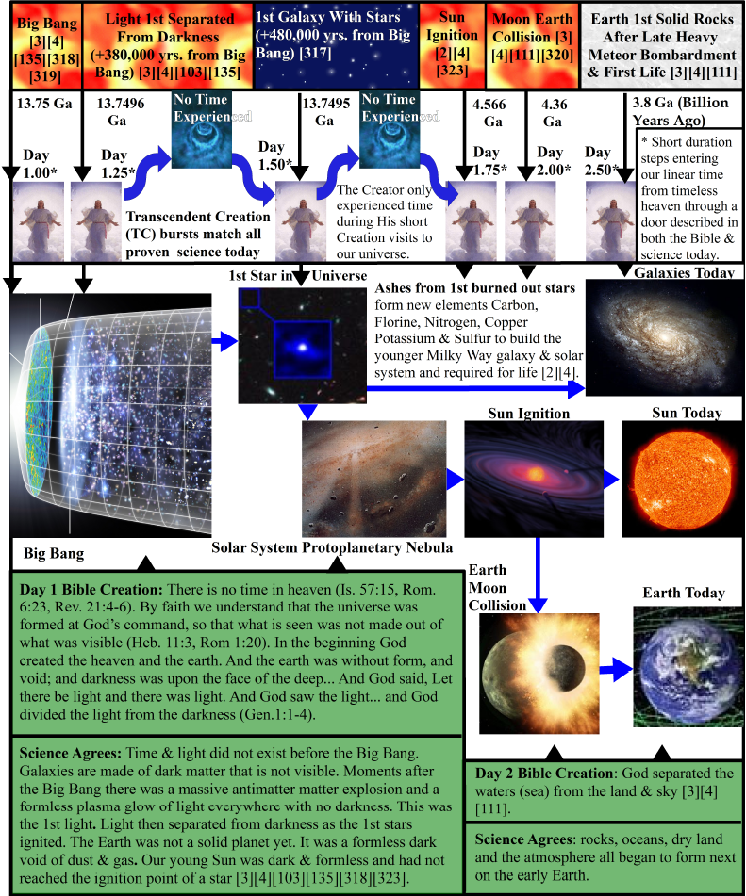
Scientific events
Full linear time, no conscious being experienced this time path
Nonlinear time God experienced
The Bible Creation Sequence Matches All Rigorously Proven Science:
Space-time fabric, wormhole doors, nonlinear time and dark matter described first in Bible.
Over 200 Anthropic Principles are required for life to exist on Earth.
Proven instant complex design bursts including Big Bang literally match details of Biblical creation days, using God’s nonlinear time.
Time is an illusion per Einstein.
The Big Bang incredibly fine-tuned mega machine is designed to clump galaxies and stars as entropy (disorder) is increased.
Literal 24 hour consecutive days in God’s nonlinear time path and the matching scientific events.

Slide 131
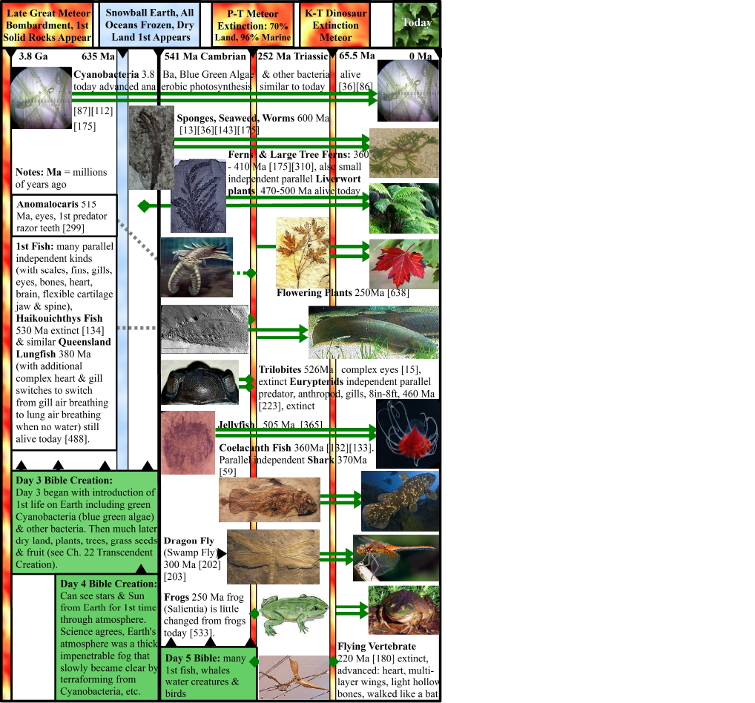
Scientific events
Full linear time, no conscious being experienced this time path
Bible Creation Sequence Matches All Rigorously Proven Science:
Incredible 250 million year fossil stasis, often with several complete body metamorphosis changes over each generation.
Incredible nanocomputers, information recognition and repair systems, 3D encryption and high resolution GPS with world wide maps found in life.
Equivalent massive gaps between each different “kind” of organism in independent rock fossils, frozen tissue & mtDNA.
Science proves 1st kind of each organism appeared suddenly, complex and fully formed.
Literal 24 hour consecutive days in God’s nonlinear time path and matching scientific events.

Slide 132
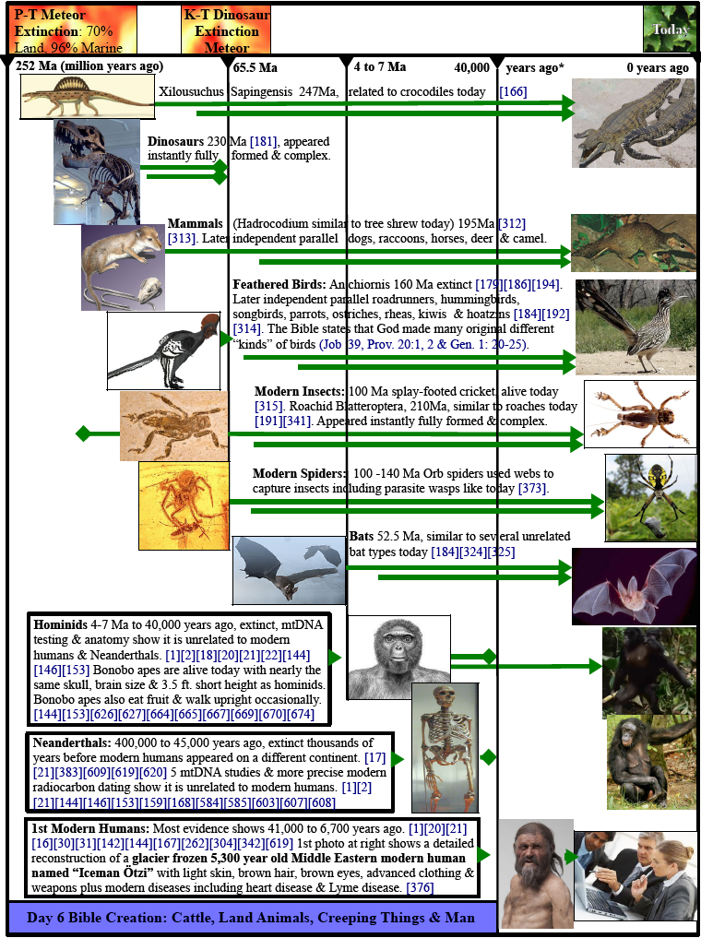
Scientific events
Full linear time, no conscious being experienced this time path
Bible Creation Sequence Matches All Rigorously Proven Science:
Incredible 250 million year fossil stasis often with several full body metamorphosis changes over each generation.
Incredible nanocomputers, information recognition and repair systems, 3D encryption and high resolution GPS with world wide maps found in life.
Equivalent massive gaps between each different “kind” of organism in independent rock fossils, frozen tissue & mtDNA.
Science proves 1st kind of each organism appeared suddenly, complex and fully formed.
Literal 24 hour consecutive days in God’s nonlinear time path and matching scientific events.

Slide 133

Miracles Analyzed Using the Rigorous Scientific Method Disprove Evolution

Slide 134
Miracles Analyzed Using the Rigorous Scientific Method Disprove Evolution
Using the rigorous scientific method, I proved that when I prayed God provided an intelligent response far beyond my level of scientific knowledge or wisdom.
Specifically requested repeating miracles occurred each time I earnestly prayed and desperately needed them.
We can only prove God scientifically to others with 99% certainty, due to God's requirement for individual faith.
But, with great faith you can repeatedly prove to yourself that God exists using the rigorous scientific method, with double blind multiple independent test results that match predictions with 100% certainty.

Slide 135
References
Quotation Notes:
See unabridged book www.advbookstore.com or www.amazon.com for complete list of over 700 references.
Words in italics are quotations from the references listed below.
Underlines, highlights and information added in parenthesis ( ) to quotations in this book were added for clarity, correction and ease of reading. These were not included in the original quotes from the referenced sources.
(...) in a quotation shows irrelevant words deleted.
[1] Dr. Fazale Rana, “Why is the Big Bang Evidence that God Created The Universe”,
The John Ankerberg Show, A.T.R.I., DVD,
  http://www.youtube.com/watch?v=HZ5BzpBdyN4
  http://www.jashow.org/Articles/science/creation-questions/SC-creation-questions.htm
[2] Dr. Hugh Ross, ”Why is the Big Bang Evidence that God Created The Universe”,
The John Ankerberg Show, A.T.R.I., DVD,
  http://www.youtube.com/watch?v=HZ5BzpBdyN4
  http://www.jashow.org/Articles/science/creation-questions/SC-creation-questions.htm
[3] Dr. Hugh Ross, ”The Creator and the Cosmos”, Book, Reasons To Believe, Navpress, 2001,
  http://www.reasons.org/explore/author/HRoss
[4] Dr. Hugh Ross, ”Journey Toward Creation”, DVD, Reasons To Believe, Global Net Productions, 2003, DVD,
  http://www.youtube.com/watch?v=r7hXHMco7tU
  http://www.reasons.org/dr-hugh-ross.html
[12] Ron Rhodes, “Making the Case for Creation Ten Things You Should Know About the Evolution vs. Creation Debate”, Origins, Program #450, retrieved (4/15/2011),
http://www.ctvn.org/programs-origins-viewshow.asp?id=10
http://www.ronrhodes.org/
[17] 454's Life Sciences Group, phone interview of chairman, Associated Press. (Over a decade ago)

Slide 136
References
[20] New York University (2011, February 16). “Fossils may look like human bones: Biological anthropologists question claims for human ancestry”. ScienceDaily. Web February 17, 2011,
http://www.sciencedaily.com/releases/2011/02/110216132034.htm
[21]Thomas Higham (Oxford University radiocarbon dating specialist, led study), ”Report: Tools may not belong to Neanderthals”, (published in Proceedings of the National Academy of Sciences), Los Angeles Times & Arizona Republic, Amina Khan
[24] Wikipedia, “Darwin”, Retrieved (3/11/2011), http://en.wikipedia.org/wiki/Charles_Darwin
[30] CBN News, “Explorers Claim They Have Found The Ark”, Retrieved (3/10/2011)
www.cbn.com/cbnnews/world/2010/April/Explorers-Claim-They-Have-Found-Noahs-Ark
[31] World Net Daily, “Evangelists Claim Noah's Ark Found”, April 27, 2010, Retrieved (3/11/2011),
www.wnd.com/?pageId=146369
[35] “The Dead Sea Scrolls Bible” (translated from the original Dead Sea Scrolls, into English),
book, pg. xiv, xv, xvi, xviii.
[48] W.J.Bencze, D.B.DeBra1, L.Herman, T.Holmes, M.Adams, G.M.Keiser, C.W.F Everitt “On-Orbit Performance
of the Gravity Probe B Drag-Free Translation Control System”, AAS 06-083, Stanford, NASA , 2006
http://einstein.stanford.edu/RESOURCES/presentations/tech_reviews/bencze-AAS06_DF_control.pdf
[49] Gravity Probe B, Testing Einstein's Universe, Mission Update November 12, 2009.
http://einstein.stanford.edu/highlights/status1.html
[72] Dr. Jerry Bergman, “Persuaded by the Evidence”, Origins, program #913
http://www.ctvn.org/programs-origins-viewshow.asp?id=62
jbergman@northweststate.edu
[73] Wikipedia, “Wernher Von Braun, Quotations”, Retrieved (4/9/2011),
http://en.wikipedia.org/wiki/Werner_Von_Braun
[86] John M. Olson, “Photosynthesis in the Archean Era” abstract from Biomedical and Life Sciences,
Photosynthesis Research, Volume 88, Number 2, 109-117, DOI: 10.1007/s11120-006-9040-5
[91] Holy Bible, King James Version, The Family Heritage Edition, “The Archaeology of the Bible” and “A
Chronology of the Old Testament Times”, pg. 5-17.

Slide 137
References
[100] Web Vision, “Feedback Loops” & “Retinal Circuits”, University of Utah,
http://webvision.med.utah.edu/book/part-iii-retinal-circuits/feedback-loops/
http://www.ncbi.nlm.nih.gov/books/NBK11555/figure/ch10rodpath.F7/?report=objectonly
[108]Hongyun Wang, ”Hongyun Wang's Research on Molecular Motors”,
http://users.soe.ucsc.edu/~hongwang/ATP_synthase.html
[109]University of Chicago, "Can Siberian hot springs reveal ancient ecology?“
ScienceDaily, 27 Apr. 2011, (Web 27 Apr. 2011),
http://www.sciencedaily.com/releases/2011/04/110426164006.htm
118]University of Rochester. "Second Depth-perception Method Discovered In Brain."
ScienceDaily, 17 Mar. 2008, (Web 29 Apr. 2011),
http://www.sciencedaily.com/releases/2008/03/080316161128.htm
[120]University of California - Berkeley. "Why the eye is better than a camera at capturing contrast and faint detail
simultaneously." ScienceDaily, 3 May 2011, (Web 4 May 2011).
http://www.sciencedaily.com/releases/2011/05/110503171734.htm
[135]Wikipedia, ”Big Bang”, Retrieved (5/10/2011)
http://en.wikipedia.org/wiki/Big_Bang
[137]NASA, Gravity Probe B, Lockheed Martin, Stanford University, ”The Gravity Probe B Experiment, Testing
Einstein's Universe” (Post Flight Analysis — Final Report Preface & Executive Summary), October 2006, web 5/10/2011 http://www.nasa.gov/pdf/168808main_gp-b_pfar_cvr-pref-execsum.pdf
[138]Noah’s Ark Ministries International (NAMI), “Hong Kong Press Conference, Exploration Team
Successfully Ventures inside 4,800-year old Wooden Structure on Snow-capped Mount Ararat
Experts and Turkish officials believe artifact is Noah's Ark”, web 5/10/2011,
http://www.noahsarksearch.net/eng/
[144] “Scientific and Biblical Response To: “Up from the Apes. Remarkable New Evidence Is Filling in the Story
of How We Became Human”, Time, August 23, 1999, posted 1/7/2000,
http://www.jashow.org/Articles/_PDFArchives/science/SC2W0304RA.pdf

Slide 138
References
[146] American Association for the Advancement of Science. "Before 'Lucy,' There Was 'Ardi': First Major
Analysis Of Early Hominid Published In Science." ScienceDaily, 1 Oct. 2009, (Web 12 May 2011),
http://www.sciencedaily.com/releases/2009/10/091001110548.htm
[154] Wikipedia, ”Chimpanzee_Genome_Project”, Retrieved (5/16/2011)
http://en.wikipedia.org/wiki/Chimpanzee_Genome_Project
[160] Yale University. "Tiny variation in one gene may have led to crucial changes in human brain."
ScienceDaily, 16 May 2011, (Web 17 May 2011),
http://www.sciencedaily.com/releases/2011/05/110515145816.htm
[169]Wikipedia, ”Origin of language, (Homo neanderthalensis)”, Web (5/20/2011)
http://en.wikipedia.org/wiki/Origin_of_language
[170]Wikipedia, ”Cranial capacity”, Web (5/20/2011),
http://en.wikipedia.org/wiki/Cranial_capacity
[180]Wikipedia, ”Pterosaur (pterodactyls)”, Web (5/25/2011),
http://en.wikipedia.org/wiki/Pterosaur
[187]University of Western Ontario (2011, April 11). “How marijuana affects the way the brain
processes emotional information”, ScienceDaily, Retrieved May 27, 2011,
http://www.sciencedaily.com/releases/2011/04/110405174833.htm
[195]Wikipedia, ”Retina”, Web (6/13/2011),
http://en.wikipedia.org/wiki/Retina
[240] Richard Nickels, "King James Version Translation Errors", (Web 11/1/2011),
http://www.servantsnews.com/PDF/kjverr01.pdf
[241] Wikipedia, “Yahweh”, (Web 11-01-11),
http://en.wikipedia.org/wiki/Yahweh
[253]Wikisource, "The Catholic Encyclopedia Louis Pasteur", (Web 11-07-11),
http://en.wikisource.org/wiki/Catholic_Encyclopedia_(1913)/Louis_Pasteur
[254]Wikipedia, “Louis Pasteur (Faith and Spirituality)”, (Web 11-07-11),
http://en.wikipedia.org/wiki/Louis_Pasteur

Slide 139
References
[255]Wikipedia, “Raymond Damadian”, (Web 11-07-11),
http://en.wikipedia.org/wiki/Raymond_Damadian
[256]Wikipedia, “Einstein (Political and Religious Views)”, (Web 11-07-11),
http://en.wikipedia.org/wiki/Einstein#Political_and_religious_views
[257]Wikipedia, “List of Christian thinkers in science”, (Web 11-07-11),
http://en.wikipedia.org/wiki/List_of_Christian_thinkers_in_science#2001.E2.80.93today_.2821st_century.29
[258]Wikipedia, “Michael Faraday”, (Web 11-07-11),
http://en.wikipedia.org/wiki/Michael_Faraday
[259]Wikipedia, “Isaac Newton”, (Web 11-07-11),
http://en.wikipedia.org/wiki/Isac_Newton
[260]Wikipedia, “James Clerk Maxwell”, (Web 11-07-11),
http://en.wikipedia.org/wiki/James_Clerk_Maxwell
[274]Wikipedia, “Received Text”, (Web 11-18-11),
http://en.wikipedia.org/wiki/Received_text
[275]Wikipedia, “Majority Text”, (Web 11-18-11),
http://en.wikipedia.org/wiki/Majority_text
[278]Wikipedia, “Dead Sea Scrolls”, (Web 11-18-11),
http://en.wikipedia.org/wiki/Dead_sea_scrolls
[279]"The Received Text"(Web 11-18-11),
http://www.americanpresbyterianchurch.org/the_received_text.htm
[280]Sir Godfrey Driver, "Introduction to the Old Testament
of the New English Bible" (Web 11-18-11),
http://www.bible-researcher.com/driver1.html
http://www.bible-researcher.com/hodges-farstad.html
[286]Wikipedia, “Ketef Hinnom”, (Web 11-27-11),
http://en.wikipedia.org/wiki/Ketef_Hinnom
[287]Wikipedia, “Tetragrammaton (YHWH)”, (Web 11-27-11),
http://en.wikipedia.org/wiki/YHWH

Slide 140
References
[289]Wikipedia, “Uranium-lead_dating”, (Web 11-27-11),
http://en.wikipedia.org/wiki/Uranium-lead_dating
[290]Wikipedia, “General Theory of Relativity Light Deflection & Gravitational Time” 11-28-11
http://en.wikipedia.org/wiki/General_theory_of_relativity#Light_deflection_and_gravitational_time_delay
[291]Wikipedia, “Time Travel (Via Faster Than Light)”, (Web 11-28-11),
http://en.wikipedia.org/wiki/Time_travel#Via_faster-than-light_.28FTL.29_travel
[292]University of Arizona. "How the brain strings words into sentences." ScienceDaily, 28 Nov. 2011,
(Web 29 Nov. 2011),
[318] Nasa.gov, "Ancient White Dwarf Stars", (Web 12-21-2011),
http://www.nasa.gov/multimedia/imagegallery/image_feature_2097.html
[319]Wikipedia, “Milky Way (age)", (web 12-21-11),
http://en.wikipedia.org/wiki/Milky_way_galaxy#Age
[329]Wikipedia, “Optical Spectroscopy", (web 1-4-12),
http://en.wikipedia.org/wiki/Optical_spectroscopy
[330]Wikipedia, “Tevatron", (web 1-4-12),
http://en.wikipedia.org/wiki/Tevatron
[331]Wikipedia, “Red Shift Light", (web 1-4-12),
http://en.wikipedia.org/wiki/Red_shift_light
[332]Wikipedia, “Lunar Laser Ranging Experiment", (web 1-4-12),
http://en.wikipedia.org/wiki/Lunar_Laser_Ranging_experiment
[346]Wikipedia, “Gravitational Time Dilation", (web 1-10-12),
http://en.wikipedia.org/wiki/Gravitational_time_dilation
[366]Scripps Research Institute. "Scientists develop biological computer to encrypt and decipher images." ScienceDaily, 7 Feb. 2012, Web 8 Feb. 2012,
http://www.sciencedaily.com/releases/2012/02/120207202803.htm
[370] NASA/WMAP Science Team, "Time Line of the Universe", (Web 2/12/2012),
http://en.wikipedia.org/wiki/File:CMB_Timeline300_no_WMAP.jpg

Slide 141
References
[376] University of Tübingen, "Initial genetic analysis reveals Iceman Ötzi predisposed to cardiovascular disease",
ScienceDaily, 28 Feb. 2012, Web 14 Jan. 2013,
http://www.sciencedaily.com/releases/2012/02/120228123847.htm
[383]Madrimasd. "Last Neanderthals of southern Iberia may not have coexisted with modern humans,
new data suggest", ScienceDaily, 4 Feb. 2013. Web 7 Feb. 2013,
http://www.sciencedaily.com/releases/2013/02/130204153714.htm
[385]http://www.sciencedaily.com/releases/2011/10/111025091533.htm
[386]University College Cork. "World's oldest shoe found in Armenia", ScienceDaily, 10 Jun. 2010. Web 10 Feb.
2013. http://www.sciencedaily.com/releases/2010/06/100609201426.htm
[387]Guillermo Gonzalez Ph.D. "The Privileged Planet", Illustra Media.
http://www.illustramedia.com/
[433]University of California - Berkeley. "New evidence suggests comet or asteroid impact
was last straw for dinosaurs", ScienceDaily, 7 Feb. 2013, (Web 3 Mar. 2013),
http://www.sciencedaily.com/releases/2013/02/130207141444.htm
[502]Wikipedia, "Louis Leakey", (web 5-31-13),
http://en.wikipedia.org/wiki/Louis_Leakey
[503]Wikipedia, "Mary Leakey", (web 5-31-13),
http://en.wikipedia.org/wiki/Mary_Douglass_Leakey
[504]Wikipedia, "Richard Leakey", (web 5-31-13),
http://en.wikipedia.org/wiki/Richard_Leakey
[505]Wikipedia, "Comet Shoemaker-Levy 9", (web 6-23-13),
http://en.wikipedia.org/wiki/Comet_Shoemaker%E2%80%93Levy_9
[506]Wikipedia, "Chicxulub crater", (web 6-23-13),
http://en.wikipedia.org/wiki/Chicxulub_crater
[507]Wikipedia, "OH 5", (web 6-23-13),
http://en.wikipedia.org/wiki/OH_5

Slide 142
References
[517]P. William Davis, Eldra Pearl Solomon, "The World of Biology" (3rd Edition University Textbook),
Saunders College Publishing, 1986, pages 641 - 643.
[526]The Guardian, "African Warrior", Oct 9 2001, (web 7/10/2013)
www.guardian.co.uk/g2/story/0,3604,565776,00.html
[527]Wikipedia, "Wormhole", (web 7-21-13),
http://en.wikipedia.org/wiki/Wormhole
[533]Wikipedia, "Salientia", (web 7-21-13),
http://en.wikipedia.org/wiki/Salientia
[534]Wikipedia, "Creation–evolution controversy", (web 7-30-13),
http://en.wikipedia.org/wiki/Creation-evolution_controversy
[538]Virginia Morell, "Ancestral Passions: The Leakey Family and the Quest for Humankind's Beginnings",
(Editorial Review From Publishers Weekly) ,Google Books, (web 8-3-13),
http://www.amazon.com/Ancestral-Passions-Leakey-Humankinds-Beginnings/dp/0684824701#reader_0684824701
[541]Wikipedia, "Jane Goodall", (web 8-1-13),
http://en.wikipedia.org/wiki/Jane_Goodall
[543]John Noble Wilford, "Mary Leakey, 83, Dies; Traced Human Dawn", NY Times, Dec. 10, 1996, (web 8-4-13),
http://www.nytimes.com/1996/12/10/world/mary-leakey-83-dies-traced-human-dawn.html?pagewanted=all&src=pm
[546]Bio Printing Explaining the Future,
http://www.youtube.com/watch?v=9D749wZSlb0
[583]Javier Espinosa, "A Portrait Of The Evolutionists As A Young Rake", Forbes, Friday, 3/23/2009,
http://www.forbes.com/2009/03/23/charles-darwin-expenses-markets-face-science.html
[587]Research Institute of Molecular Pathology. "Bird navigation: Great balls of iron."
ScienceDaily, 26 Apr. 2013. Web 6 Sept. 2013.
http://www.sciencedaily.com/releases/2013/04/130426073811.htm

Slide 143
References
[588]Dr. Hugh Henry, PhD, "Animal Magnetoreceptor Cells—Evidence of Design? Part 1",
Reasons To Believe, 2/18/2013, (web 9-2-13),
http://www.reasons.org/articles/animal-magnetoreceptor-cells-evidence-of-design-part-1
[609]Plataforma SINC. "Scientists provide a more accurate age for the El Sidrón cave Neanderthals."
ScienceDaily, 2 Apr. 2013. Web. 15 Sep. 2013.
http://www.sciencedaily.com/releases/2013/04/130402091145.htm
[614]Jane Gitschier, "Imagine: An Interview with Svante Pääbo", US National
Library of Medicine, National Institutes of Health, PLOS Genetics, 3/04/2008, (web 9-16-13),
http://www.plosgenetics.org/article/info%3Adoi%2F10.1371%2Fjournal.pgen.1000035
[615] http://www.ncbi.nlm.nih.gov/pmc/articles/PMC2274957/
[616]Wikipedia, "Svante Paabo", (web 9-16-13),
http://en.wikipedia.org/wiki/Svante_Paabo
[617]Afarensis, FCD, "Svante Pääbo on Religion", Afarensis, Anthropology,
Evolution and Science", Edge, July 10, 2009, (web 9-16-13),
http://afarensis99.wordpress.com/2009/07/10/svante-paabo-on-religion/
[618]"Mapping The Neanderthal Genome (A Conversation with Svante Pääbo,
Topic LIFE)", Edge, 7/4/09, (web 9-16-13),
http://edge.org/conversation/mapping-the-neanderthal-genome
[619]University of Oxford. "Dating of beads sets new timeline for early humans.“
ScienceDaily, 13 Sep. 2013. Web. 20 Sep. 2013.
[622]Wikipedia, "Mule", (web 9-22-13),
http://en.wikipedia.org/wiki/Mule
[624]Wikipedia, "Neanderthal Genome Project", (web 9-24-13),
http://en.wikipedia.org/wiki/Neanderthal_genome_project
[626]Reasons to Believe, "Wide-Hipped Fossil Changes Picture of Homo Erectus", (web 9/25/2013),
http://www.reasons.org/podcasts/science-news-flash/wide-hipped-fossil-changes-picture-of-homo-erectus

Slide 144
References
[627]Yahoo! News, "Wide-Hipped Fossil Changes Picture of Homo Erectus," by Maggie Fox, November 13, 2008,
http://news.yahoo.com/s/nm/20081113/sc_nm/us_humans_erectus_1
[630]Wikipedia, "Darwin's Illness" (web 9-30-2013),
http://en.wikipedia.org/wiki/Darwin%27s_illness
[631]Wikipedia, "File: Charles Darwin.jpeg" (web 9-30-2013),
http://en.wikipedia.org/wiki/File:Charles_Darwin.jpg
[632]Jennie Cohen, "What Killed Charles Darwin", History In The Headlines, 5/11/2011, (web 9-30-2013),
http://www.history.com/news/what-killed-charles-darwin
[633]Bartow (Nora ed.), "The autobiography of Charles Darwin 1809-1882", 1958, pg. 144,
http://darwin-online.org.uk/content/frameset?viewtype=text&itemID=F1497&pageseq=150
[640]Bettmen / Corbis, "Mary Leakey Excavating"
http://www.corbisimages.com/stock-photo/rights-managed/U1197916/mary-leakey-excavating?popup=1&caller=enlargement
[664]Ian Sample, science correspondent, "Skull of Homo erectus throws story of human evolution
into disarray (A haul of fossils found in Georgia suggests that half a dozen species of
early human ancestor were actually all Homo erectus)", The Guardian, 17 October 2013,
14.00 EDT, (17 October 2013),
http://www.theguardian.com/science/2013/oct/17/skull-homo-erectus-human-evolution
[667]Wikipedia, "Bonobo", (web 10-20-13),
http://en.wikipedia.org/wiki/Bonobo
[668]Skulls Unlimited, "Bonobo Skull", (web 10/20/2013),
http://www.skullsunlimited.com/record_species.php?id=1424
[669]Bonobo ape study & video,
http://www.youtube.com/watch?v=l0tAQcpLILQ
[670]Bonobo ape walking comparison to Homo erectus & humans video,
http://www.youtube.com/watch?v=3Sjkv29k3cw

Slide 145
References
[674]Wikipedia, "Chimpanzee", (web 11-01-13),
http://en.wikipedia.org/wiki/Chimpanzees
[681]Massachusetts Institute of Technology. "You can't get entangled without a wormhole:
Physicist finds entanglement instantly gives rise to a wormhole." ScienceDaily, 5 Dec. 2013. Web. 9 Dec. 2013.
http://www.sciencedaily.com/releases/2013/12/131205142218.htm
[682]Gallop, ”Evolution, Creationism, Intelligent Design” 2012,
http://www.gallup.com/poll/21814/evolution-creationism-intelligent-design.aspx
[706]”Pat Robertson Attacks Ken Ham and Creationism after Bill Nye Science Guy Debate”, (Web 2/25/2014),
http://www.youtube.com/watch?v=I37wUKtX810
[707]Wikipedia, "James Ussher", (web 2-25-14),
http://en.wikipedia.org/wiki/James_Ussher
[716]Wikipedia, “Honorary Degrees”, (web 3-10-2014),
http://en.wikipedia.org/wiki/Honorary_degree
[717]Fritz Ridenour, Jack Durkee, “Who Says GOD CREATED”, 1968,
Regal Books Division G/L Publications, pg. 13-24, 140-161.
[747]Brian Greene, “The Fabric of the Cosmos – The Illusion of Time”, video,
http://youtu.be/VYZQxMowBsw
[748]Honor Whiteman, ” Cannabis use alters DNA to increase disease risk, study says”,
Medical News Today, 5-25-2016, (Web 7-13-2016).
http://www.medicalnewstoday.com/articles/310534.php
[749]National Institute on Drug Abuse, “What are the effects of maternal cocaine use?”, (Web 7-13-2016),
https://www.drugabuse.gov/publications/research-reports/cocaine/what-are-effects-maternal-cocaine-use
[750]Dwayne Brown, Laurie Cantillo, Guy Webster Gina Anderson, editor Gina Anderson,
“NASA Confirms Evidence That Liquid Water Flows on Today’s Mars”, 9/28/2015, (web 7-15-2016),
http://www.nasa.gov/press-release/nasa-confirms-evidence-that-liquid-water-flows-on-today-s-mars
[751]Wikipedia, “Human Genome”, (web 7-26-2016),
https://en.wikipedia.org/wiki/Human_genome

